Slide 1

Variant calling and association studies
James Prendergast
Roslin Institute, University of Edinburgh
12 February, 2017

Slide 2
Schedule
Topics
Variant calling with the Genome Analysis Toolkit (GATK)
Variant annotation with Variant Effect Predictor (VEP)
Variant filtering with VCFtools
Performing a genetic association study with PLINK (2)

Slide 3
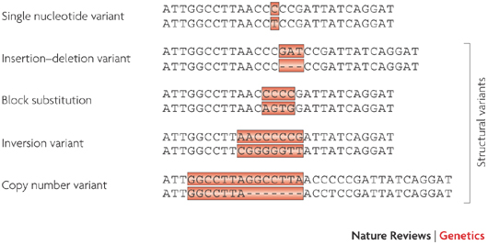
Types of genetic variants
Easier to call
(SNP)
(INDEL)
Difficult to call
Millions of genetic variants per mammalian genome
Nature Reviews Genetics 10, 241-251 (April 2009)

Slide 4
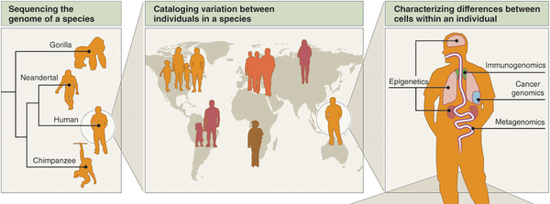
Why study genetic variants
Study of recent genome evolution
Study of ancient genome evolution
Identification of disease/trait genes
Study of genetics of species specific traits
Study of somatic mutations in cancer cells
Studying the gut microbiome and its link to traits
http://www.nature.com/nbt/journal/v30/n11/full/nbt.2421.html

Slide 5
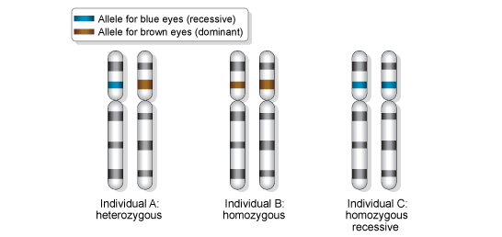
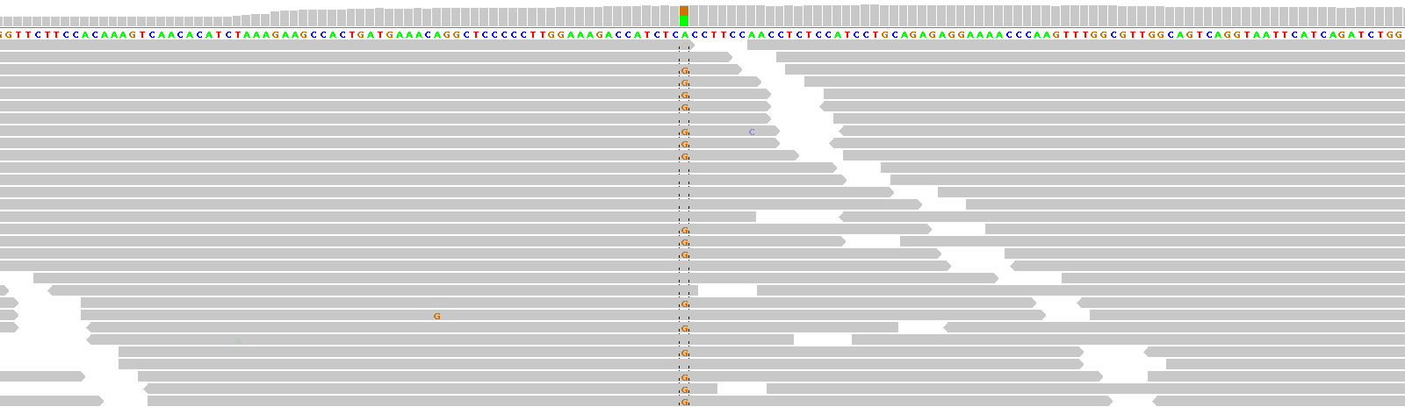
Variants called relative to a haploid reference
However humans and livestock are diploid
A
T
A
C
G
A
T
C
T
C
A
T
A
C
G
A
T
C
T
C
A
T
G
C
G
A
T
C
T
C
A
T
G
C
G
A
T
C
T
C
A
T
G
C
G
A
T
C
T
C
Reference is A at position
But some reads carry an A and some a G
Reference chromosome
Individual 1 A/C heterozygote
Individual 2 C/C homozygote

Slide 6
Basis of variant calling
ATTACGCAT TCGATAGCATTT ATTACGCATTCGTATGC GATTCGATAGCATTT
ATTACGCATTCGTATGCTTGATTGGAATTCGATAGCATTT
ATTACGCATTCGTATGCTTGATTGGAATTCGATAGCATTT
ATTACGCATTCGTATGCTTGATTGGGATTCGATAGCATTA
ATTACGCATTCGTATGCTTGATTGGGATTCGATAGCATTT
ATTACGCATTCGTATGCTTGATTGGAATTCGATAGCATTT
Aligned reads
Reference
ATTACGCATTCGTATGCTTCATTGGGATTCGATAGCATTT
Heterozygote A/G
Sequencing error
Homozygote G/G

Slide 7
Not so simple…
Sequencing errors
With best technologies ~1% of base calls are wrong. Corresponds to ~900 million errors in a 30x cow genome dataset!
Errors are often not random e.g. more common in homopolymer runs (e.g. AAAA)
PCR errors
Errors introduced in PCR amplification steps
PCR duplicates
Mapping errors
Many regions of high homology in most genomes. Reads often mapped to wrong place
Mapping to regions contain indels very difficult
Solution: Use Genome Analysis ToolKit (GATK) variant caller

Slide 8
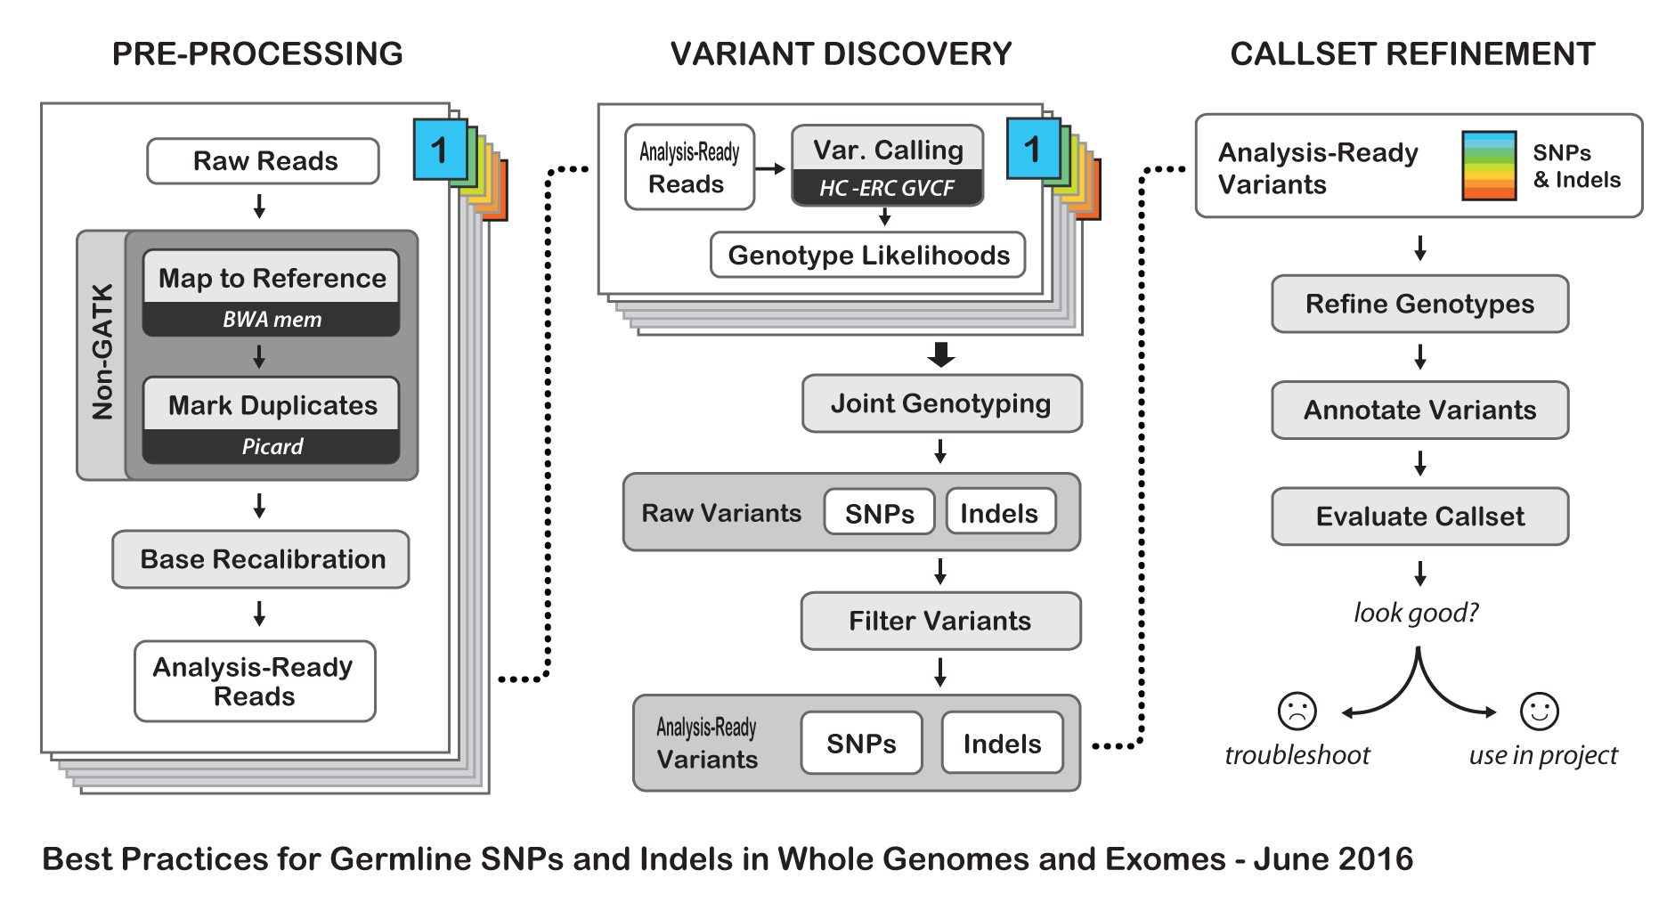
Today’s tutorial

Slide 9
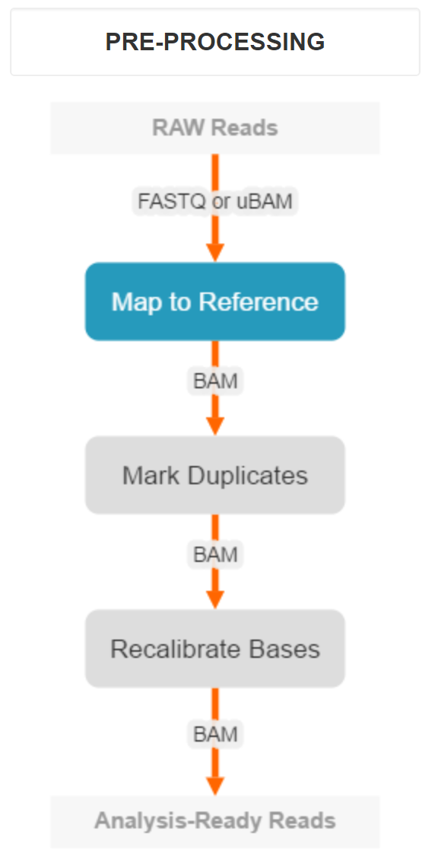
First align reads to genome
Reads most often mapped with BWA to produce aligned BAM file

Slide 10
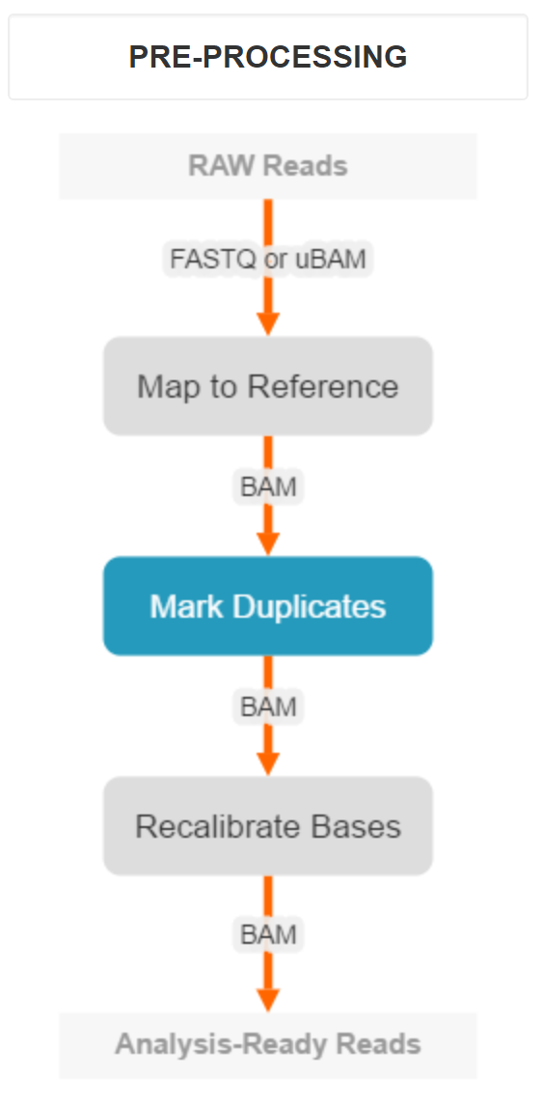
Problem of PCR duplicates
PCR amplify
Multiple copies of identical region
with same introduced error

Slide 11
G/T heterozygote SNP?
ATTACGCAT TCGATAGCATTT ATTACGCATTCGTATGC GATTCGATAGCATTT
ATTACGCATTCGTATGCTTCATTGGGATTCTATAGCATTT
ATTACGCATTCGTATGCTTCATTGGGATTCGATAGCATTT
ATTACGCATTCGTATGCTTCATTGGGATTCTATAGCATTT
ATTACGCATTCGTATGCTTCATTGGGATTCTATAGCATTT
ATTACGCATTCGTATGCTTCATTGGGATTCGATAGCATTT
Duplicates
ATTACGCATTCGTATGCTTCATTGGGATTCGATAGCATTT
Remove duplicates
ATTACGCAT TCGATAGCATTT ATTACGCATTCGTATGC GATTCGATAGCATTT
ATTACGCATTCGTATGCTTCATTGGGATTCGATAGCATTT
ATTACGCATTCGTATGCTTCATTGGGATTCTATAGCATTT
ATTACGCATTCGTATGCTTCATTGGGATTCGATAGCATTT
ATTACGCATTCGTATGCTTCATTGGGATTCGATAGCATTT
Actually homozygote G/G with a PCR error?

Slide 12
How to identify duplicates
Find reads in sam/bam file mapping to exactly same position
Read(s) with highest total quality set as primary. Remaining set as duplicates
Can use the MarkDuplicates or MarkDuplicatesWithMateCigar programs in Picard software suite
Input: Bam file
Output: Bam file with duplicate reads marked up. Metrics file of duplicate counts
java -jar picard.jar MarkDuplicatesWithMateCigar \ I=input.bam \ O=mark_dups.bam \ M=mark_dups_metrics.txt

Slide 13
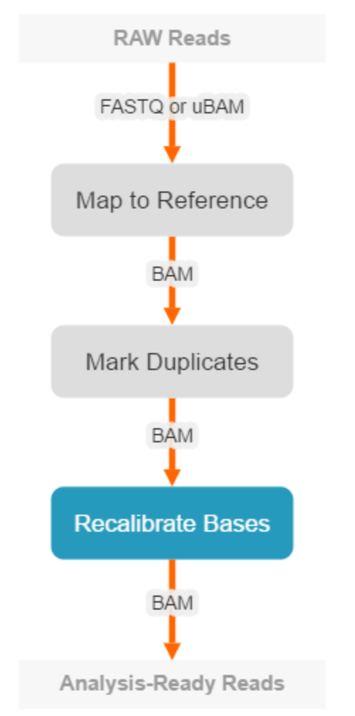
Base Recalibration
Recap:
Each sequence base is associated with a quality score
Quality score is sequencing machines best guess as to whether the base call is correct
@SEQ_ID
GATTTGGGGTTCAAAGCAGTATCGATCAAATAGTAAATCCATTTGTTCAACTCACAGTTT
+
!''*((((***+))%%%++)(%%%%).1***-+*''))**55CCF>>>>>>CCCCCCC65
Unfortunately sequencing machine quality scores can be inaccurate
Potentially causing less accurate variant calls
Aim of base recalibration is to generate more accurate quality scores

Slide 14
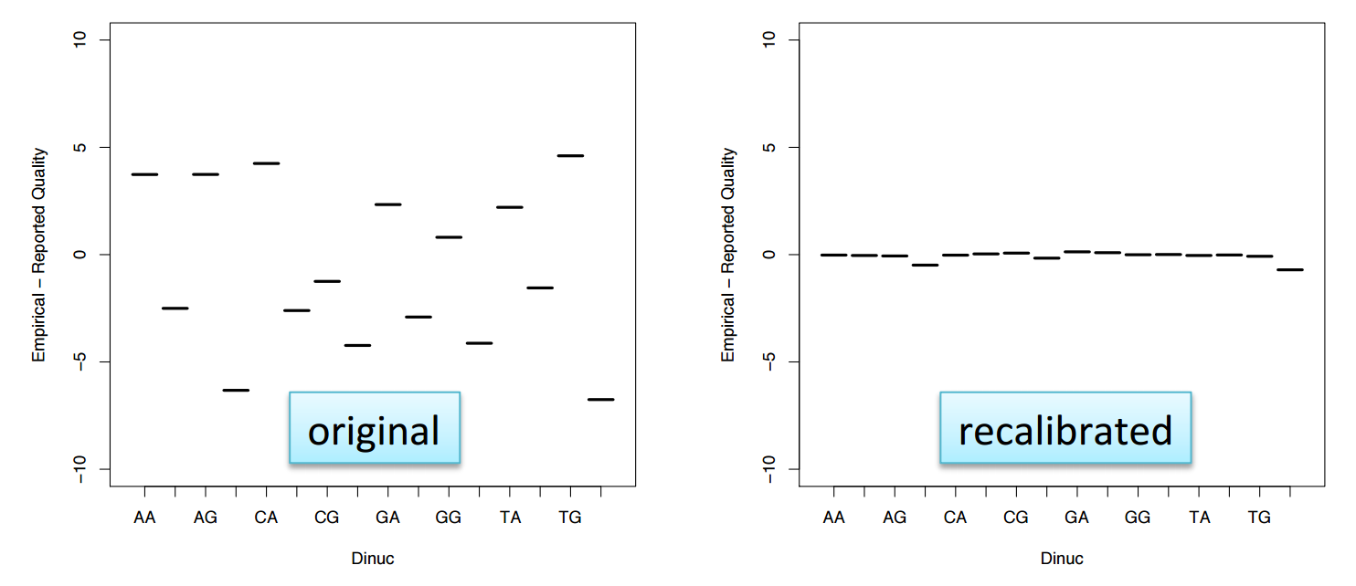
How base recalibration works
Step 1: Identify all sites where a read doesn’t match the reference base
Step 2: Throw away any of these sites matching known polymorphisms
Step 3: Work out how often remaining mismatches arise in certain contexts, read positions
Step 4: Use these frequencies to adjust quality scores
Example – T nucleotides followed by a G have a machine assigned average quality of 30
This suggests error rate is one in a 1000 (i.e. 0.1%)
However T nucleotides followed by a G are found to mismatch the genome 1% of the time
This suggests mean quality of these sites should be adjusted to 20

Slide 15
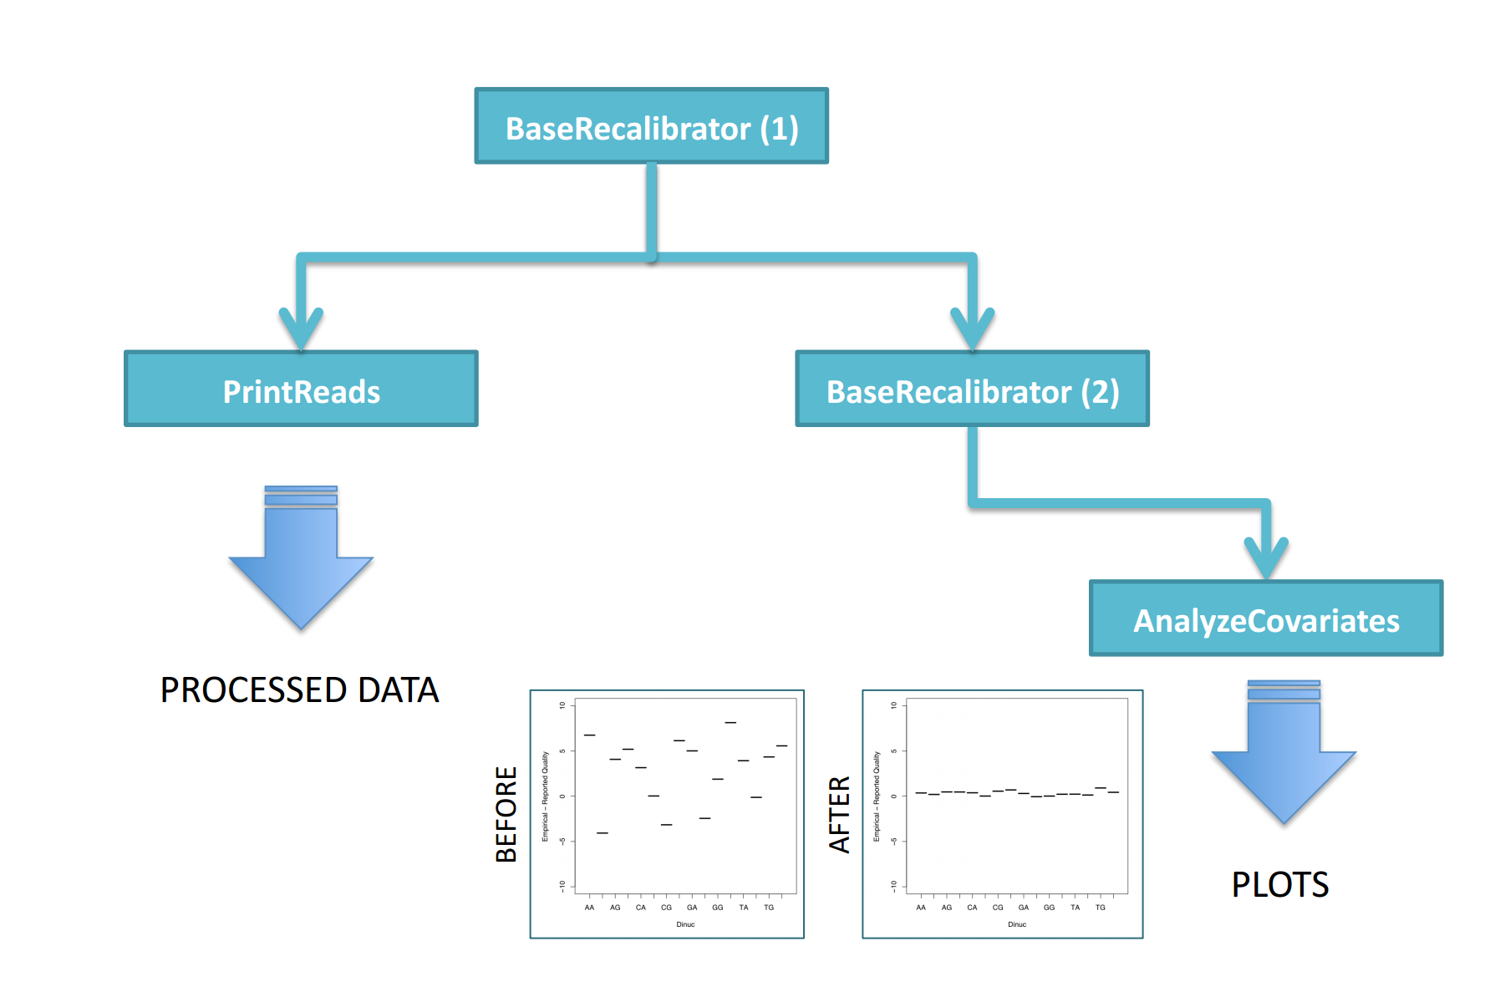
How base recalibration works

Slide 16
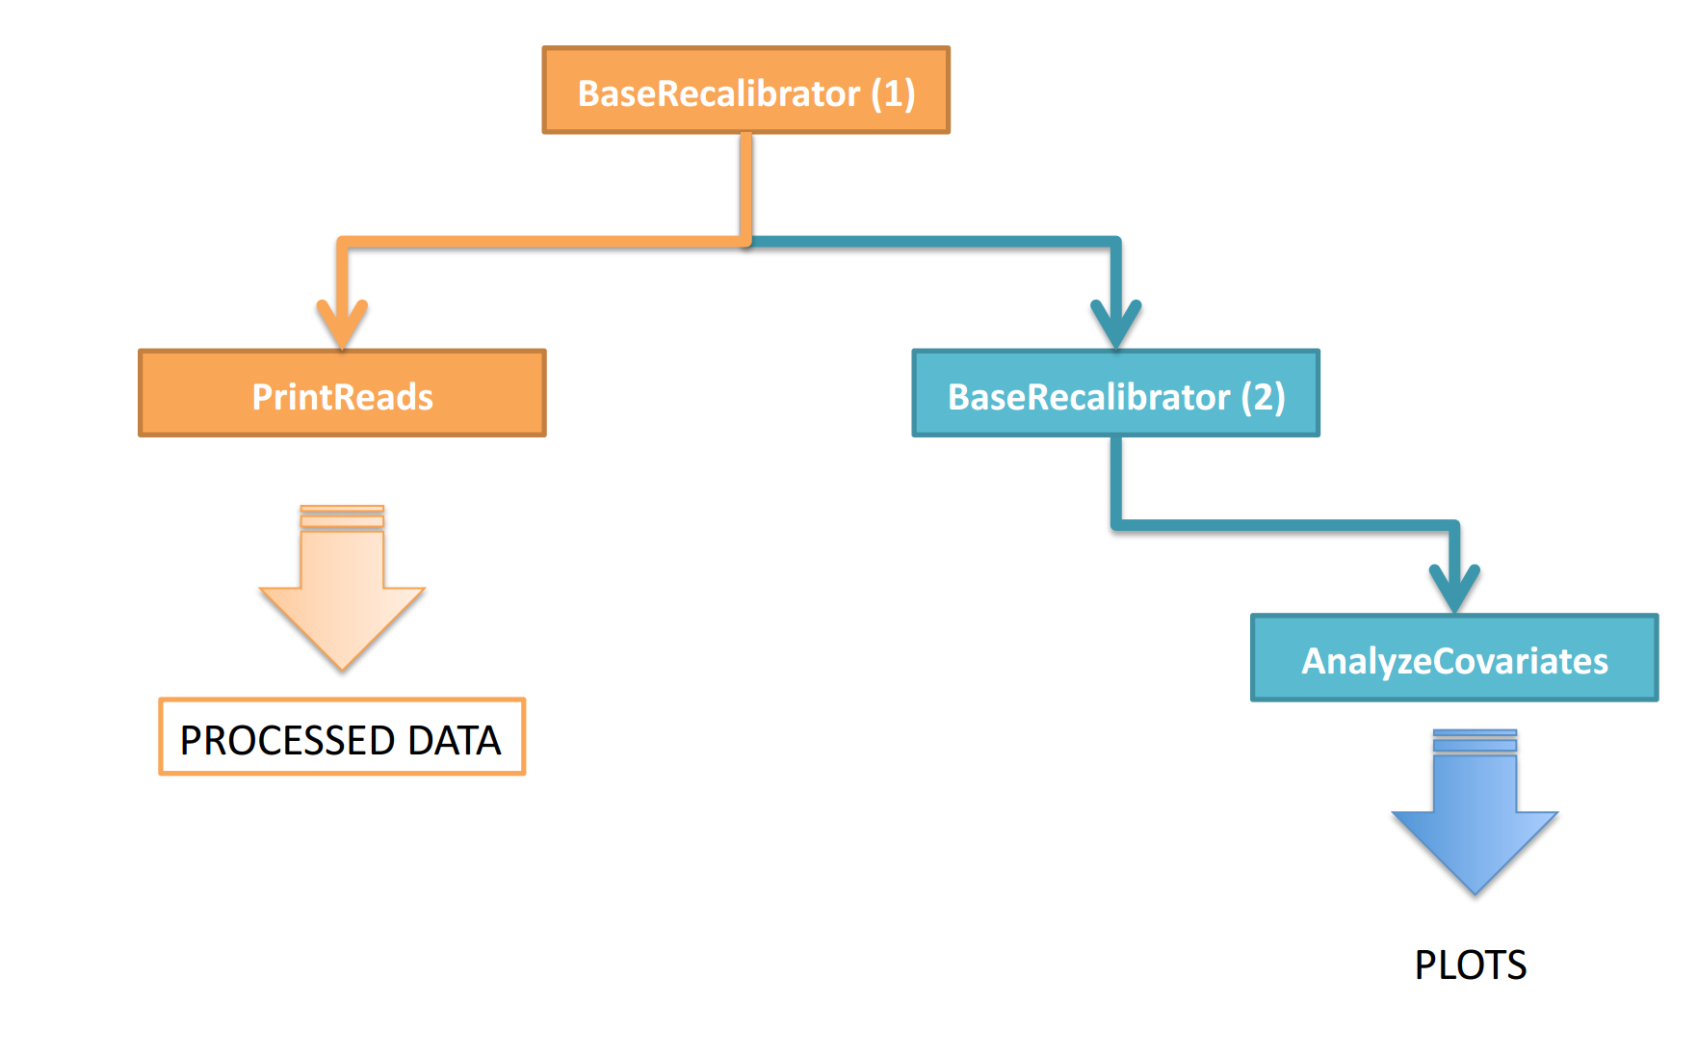
First apply recalibration
java -jar GenomeAnalysisTK.jar \
-T BaseRecalibrator \
-R reference.fasta \
-I my_reads.bam \
-knownSites latest_dbsnp.vcf \
-o recal_data.table
java -jar GenomeAnalysisTK.jar \
-T PrintReads \
-R reference.fasta \
-I input.bam \
-BQSR recalibration_report.grp \
-o output.bam

Slide 17
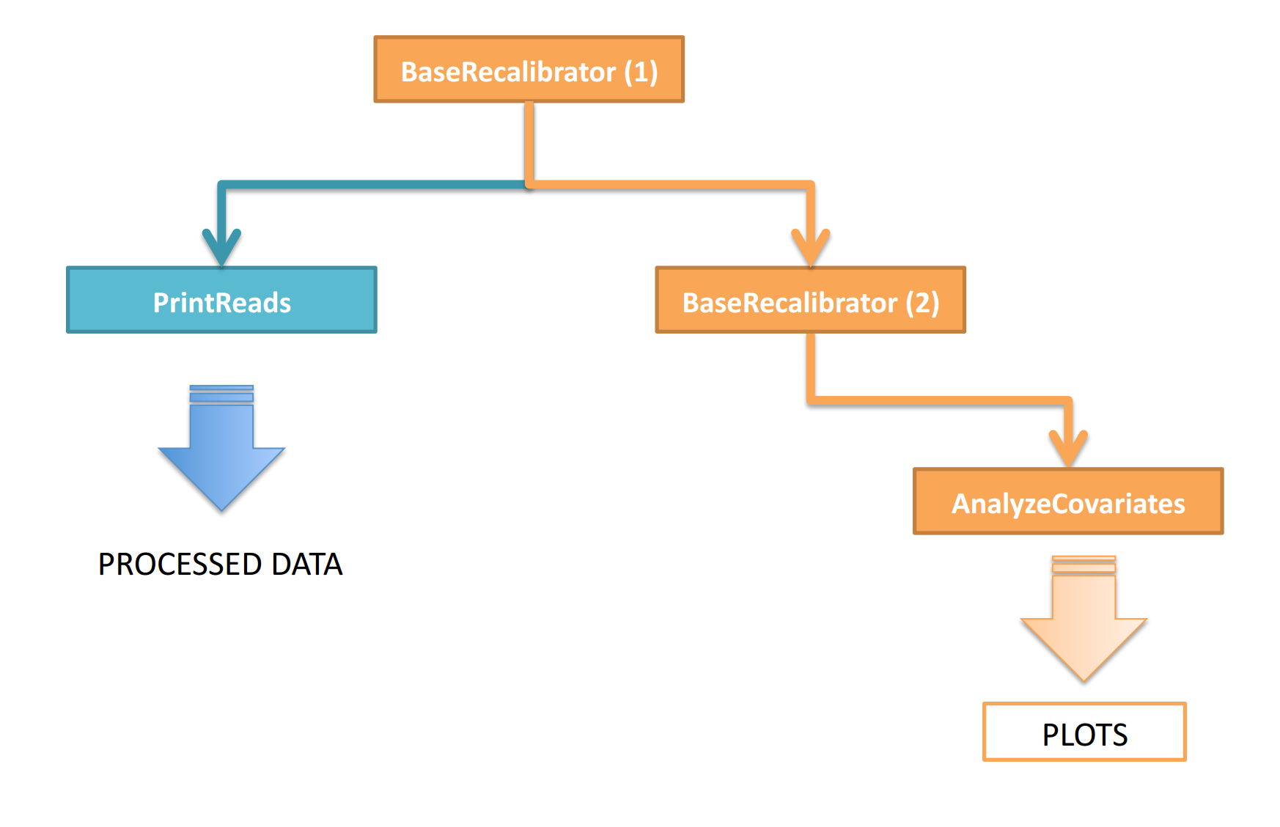
Check recalibration (optional)

Slide 18
https://github.com/prenderj/variant_tutorial
Steps 1 to 4

Slide 19
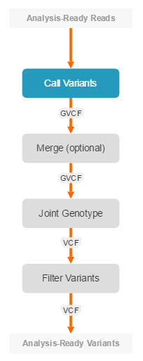
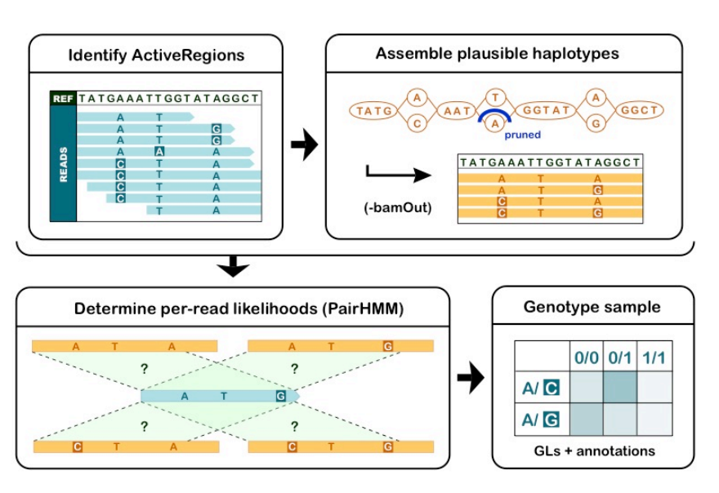
Haplotype caller

Slide 20
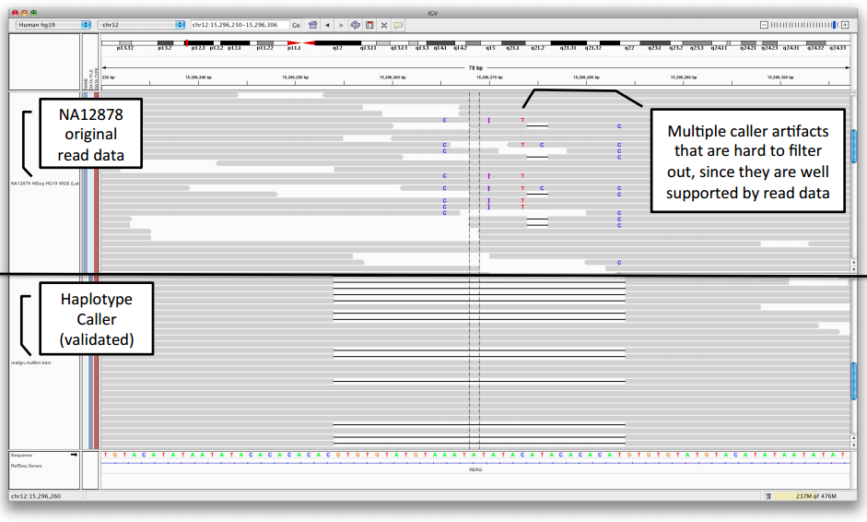
Haplotype caller
Active regions are those genomic windows containing genetic variation above a certain level
Alignments at these regions are in effect thrown away and it starts again

Slide 21
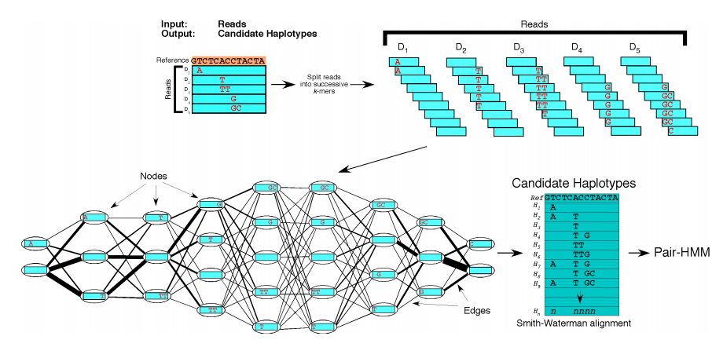
Haplotype caller

Slide 22
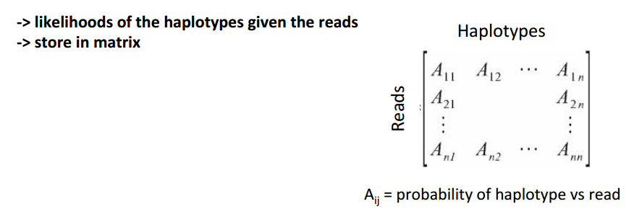
Haplotype caller
Align each read in region to each of the haplotypes determined in previous step
Mismatch penalties determined from base quality scores

Slide 23
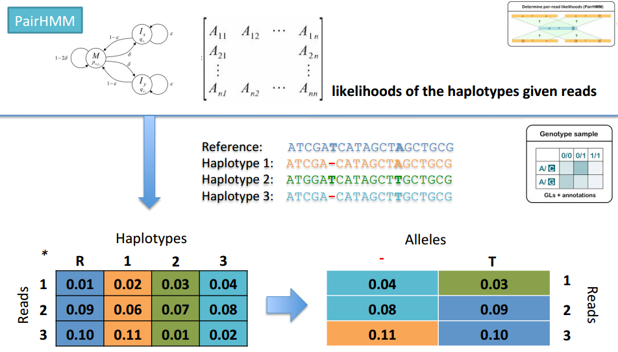
Haplotype caller
Take highest probability of haplotype given the reads that contain the corresponding allele

Slide 24
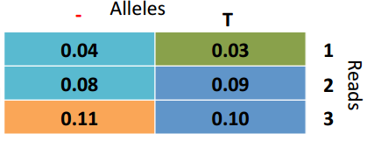
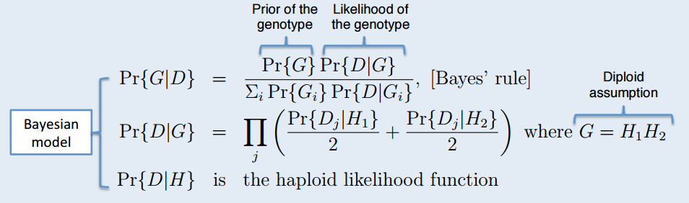
Haplotype caller
What is the most likely genotype of the sample given the data

Slide 25
Bayesian statistics basics
Come up with prior hypothesis as to probability of event occurring e.g. probability of bases mutating, frequency of variants in the genome etc. This is the prior probability
Probability of event given the data you have got e.g. reads mismatching the genome. This is the likelihood
Posterior probability is the result of adjusting your prior given the likelihood, i.e. given the data
Posterior probability ≈ prior probability x likelihood

Slide 26
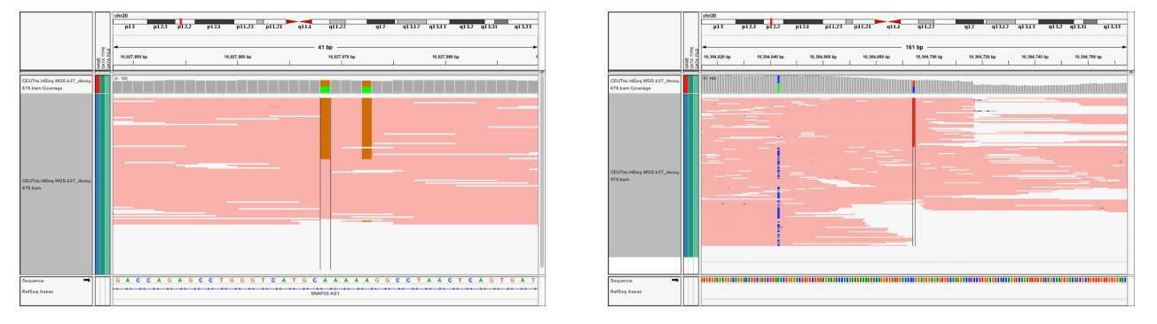
Haplotype caller gives phase info
A
C
C
A
SNP1 is A/C
Is it:
Or is it:
SNP2 is G/T
G
T
G
T

Slide 27
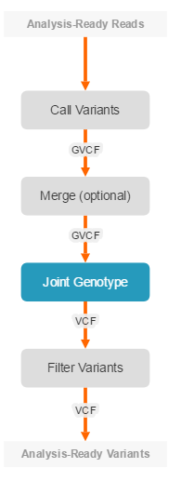
Joint calling
T
Individual 1
T
T
A
T
T
Individual 2
T
T

Slide 28
Joint calling
T
Individual 1
T
T
A
T
T
Individual 2
T
T
A
Individual 3
A
A
A
Individual 3 adds support that individual 1 is heterozygote
Modify the Bayesian maths to account for observations of allele frequencies across samples

Slide 29
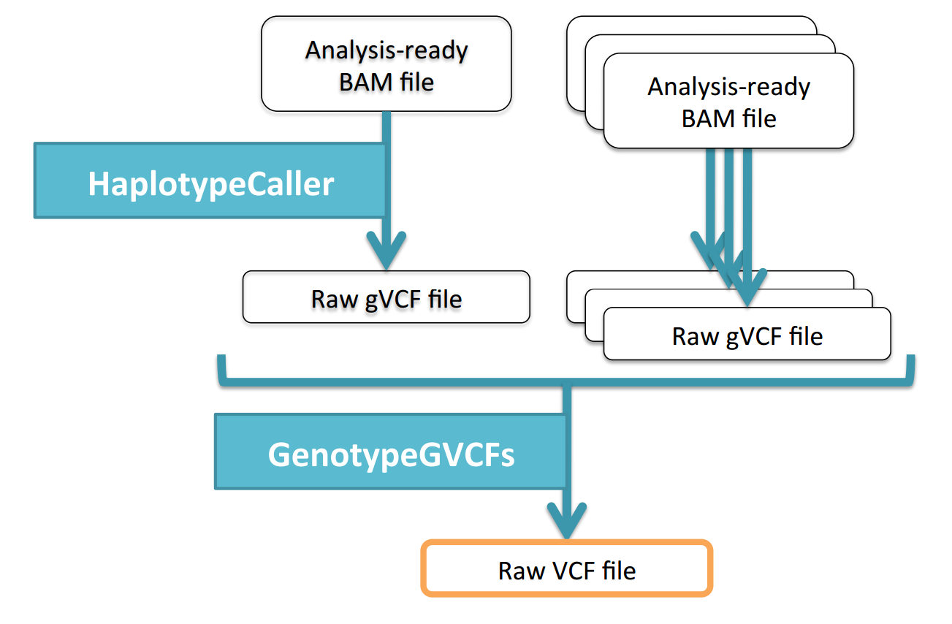
Joint calling
Run HaplotypeCaller on each sample to generate gVCF files
Run GenotypeGVCFs to call polymorphic sites (for large datasets run batches)

Slide 30
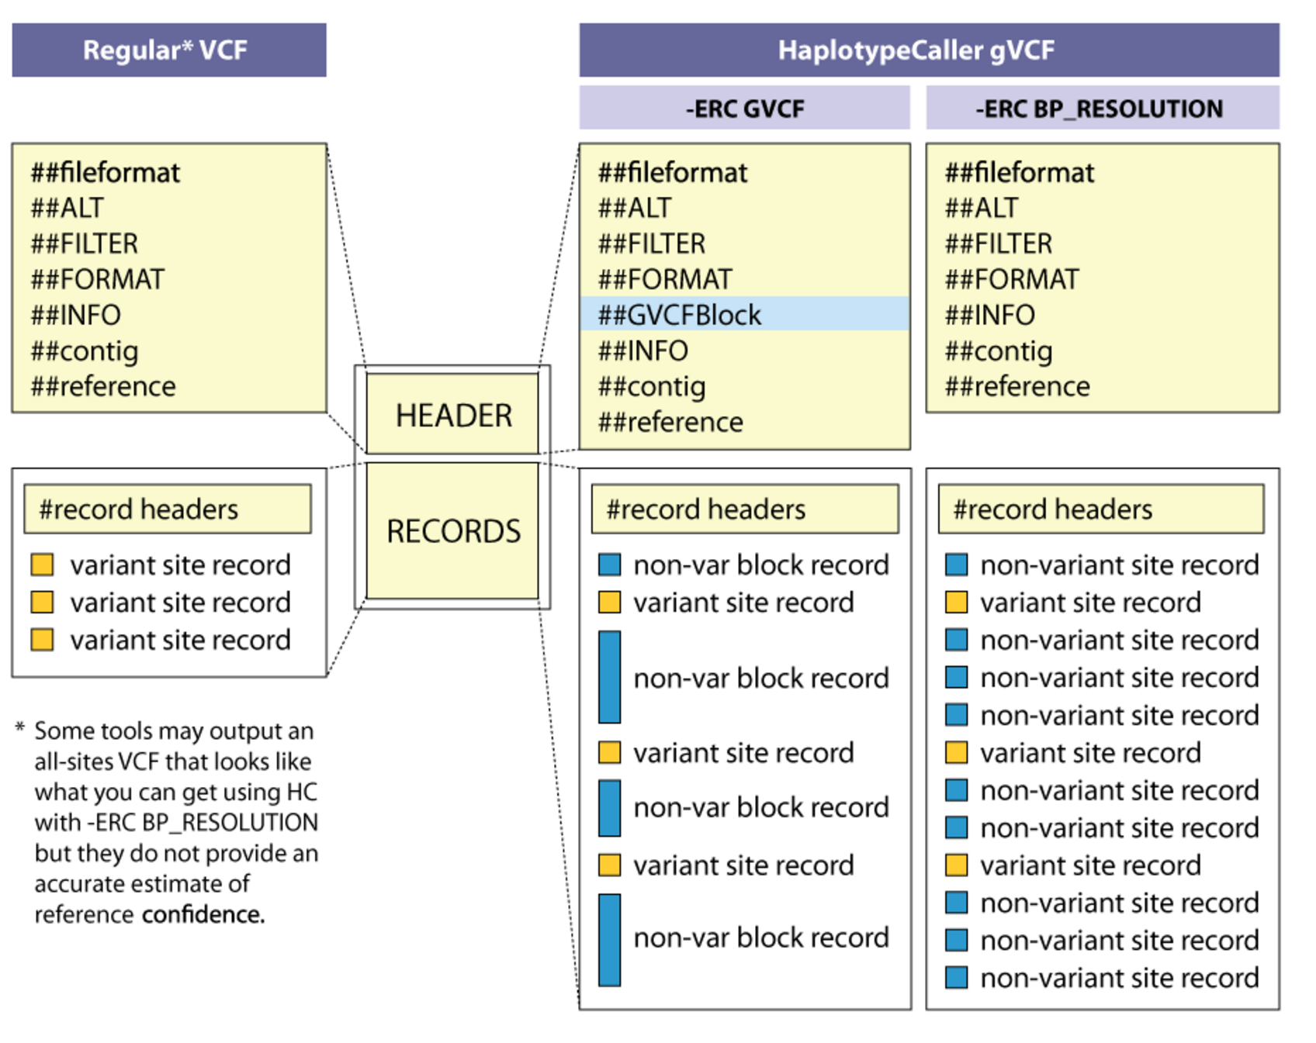
VCF and gVCF formats

Slide 31
The gVCF file
##fileformat=VCFv4.1 ##ALT=<ID=NON_REF,Description="Represents any possible alternative allele at this location">
##FILTER=<ID=LowQual,Description="Low quality">
##FORMAT=<ID=AD,Number=.,Type=Integer,Description="Allelic depths for the ref and alt alleles in the order listed">
##FORMAT=<ID=DP,Number=1,Type=Integer,Description="Approximate read depth (reads with MQ=255 or with bad mates are filtered)">
##FORMAT=<ID=GQ,Number=1,Type=Integer,Description="Genotype Quality">
##FORMAT=<ID=GT,Number=1,Type=String,Description="Genotype">
##FORMAT=<ID=MIN_DP,Number=1,Type=Integer,Description="Minimum DP observed within the GVCF block">
##FORMAT=<ID=PL,Number=G,Type=Integer,Description="Normalized, Phred-scaled likelihoods for genotypes as defined in the VCF specification">
##FORMAT=<ID=SB,Number=4,Type=Integer,Description="Per-sample component statistics which comprise the Fisher's Exact Test to detect strand bias.">
##GVCFBlock=minGQ=0(inclusive),maxGQ=5(exclusive)
##GVCFBlock=minGQ=20(inclusive),maxGQ=60(exclusive)
##GVCFBlock=minGQ=5(inclusive),maxGQ=20(exclusive)
##GVCFBlock=minGQ=60(inclusive),maxGQ=2147483647(exclusive)
##INFO=<ID=BaseQRankSum,Number=1,Type=Float,Description="Z-score from Wilcoxon rank sum test of Alt Vs. Ref base qualities">
##INFO=<ID=ClippingRankSum,Number=1,Type=Float,Description="Z-score From Wilcoxon rank sum test of Alt vs. Ref number of hard clipped bases">
##INFO=<ID=DP,Number=1,Type=Integer,Description="Approximate read depth; some reads may have been filtered">
##INFO=<ID=DS,Number=0,Type=Flag,Description="Were any of the samples downsampled?">
##INFO=<ID=END,Number=1,Type=Integer,Description="Stop position of the interval">
##INFO=<ID=HaplotypeScore,Number=1,Type=Float,Description="Consistency of the site with at most two segregating haplotypes">
##INFO=<ID=InbreedingCoeff,Number=1,Type=Float,Description="Inbreeding coefficient as estimated from the genotype likelihoods per-sample when compared against the Hardy-Weinberg expectation">
##INFO=<ID=MLEAC,Number=A,Type=Integer,Description="Maximum likelihood expectation (MLE) for the allele counts (not necessarily the same as the AC), for each ALT allele, in the same order as listed">
##INFO=<ID=MLEAF,Number=A,Type=Float,Description="Maximum likelihood expectation (MLE) for the allele frequency (not necessarily the same as the AF), for each ALT allele, in the same order as listed">
##INFO=<ID=MQ,Number=1,Type=Float,Description="RMS Mapping Quality">
##INFO=<ID=MQ0,Number=1,Type=Integer,Description="Total Mapping Quality Zero Reads">
##INFO=<ID=MQRankSum,Number=1,Type=Float,Description="Z-score From Wilcoxon rank sum test of Alt vs. Ref read mapping qualities">
##INFO=<ID=ReadPosRankSum,Number=1,Type=Float,Description="Z-score from Wilcoxon rank sum test of Alt vs. Ref read position bias">
##contig=<ID=20,length=63025520,assembly=b37>
##reference=file:///humgen/1kg/reference/human_g1k_v37.fasta
Variant rows
Header
#CHROM POS ID REF ALT QUAL FILTER INFO FORMAT NA12878
20 10000000 . T <NON_REF> . . END=10000116 GT:DP:GQ:MIN_DP:PL 0/0:44:99:38:0,89,1385
20 10000117 . C T,<NON_REF> 612.77 . BaseQRankSum=0.000;ClippingRankSum=-0.411;DP=38;MLEAC=1,0;MLEAF=0.500,0.00;MQ=221.39;MQ0=0;MQRankSum=-2.172;ReadPosRankSum=-0.235 GT:AD:DP:GQ:PL:SB 0/1:17,21,0:38:99:641,0,456,691,519,1210:6,11,11,10
20 10000118 . T <NON_REF> . . END=10000210 GT:DP:GQ:MIN_DP:PL 0/0:42:99:38:0,80,1314
20 10000211 . C T,<NON_REF> 638.77 . BaseQRankSum=0.894;ClippingRankSum=-1.927;DP=42;MLEAC=1,0;MLEAF=0.500,0.00;MQ=221.89;MQ0=0;MQRankSum=-1.750;ReadPosRankSum=1.549 GT:AD:DP:GQ:PL:SB 0/1:20,22,0:42:99:667,0,566,728,632,1360:9,11,12,10
20 10000212 . A <NON_REF> . . END=10000438 GT:DP:GQ:MIN_DP:PL 0/0:52:99:42:0,99,1403
20 10000439 . T G,<NON_REF> 1737.77 . DP=57;MLEAC=2,0;MLEAF=1.00,0.00;MQ=221.41;MQ0=0 GT:AD:DP:GQ:PL:SB 1/1:0,56,0:56:99:1771,168,0,1771,168,1771:0,0,0,0
20 10000440 . T <NON_REF> . . END=10000597 GT:DP:GQ:MIN_DP:PL 0/0:56:99:49:0,120,1800
20 10000598 . T A,<NON_REF> 1754.77 . DP=54;MLEAC=2,0;MLEAF=1.00,0.00;MQ=185.55;MQ0=0 GT:AD:DP:GQ:PL:SB 1/1:0,53,0:53:99:1788,158,0,1788,158,1788:0,0,0,0
20 10000599 . T <NON_REF> . . END=10000693 GT:DP:GQ:MIN_DP:PL 0/0:51:99:47:0,120,1800
…….
gVCF has a record for each site i.e. includes homozygote reference calls and confidences
Non-variant sites can be specified individually or in blocks (as above)

Slide 32
Joint calling
Run HaplotypeCaller on each sample to generate gVCF files
Run GenotypeGVCFs across multiple samples to call polymorphic sites (for large datasets run batches)

Slide 33
The VCF file
Individual 1
Individual 2
[HEADER LINES]
#CHROM POS ID REF ALT QUAL FILTER INFO FORMAT NA12878 NA12879
1 873762 . T G 5231.78 PASS [ANNOTATIONS] GT:AD:DP:GQ:PL 0/1:173,141:282:99:255,0,255 0/0:173,141:282:99:255,0,255
1 877664 rs3828047 A G 3931.66 PASS [ANNOTATIONS] GT:AD:DP:GQ:PL 1|1:0,105:94:99:255,255,0 1|1:0,105:94:99:255,255,0
1 899282 rs28548431 C T 71.77 PASS [ANNOTATIONS] GT:AD:DP:GQ:PL 0/1:1,3:4:26:103,0,26 0/1:173,141:282:99:255,0,255
1 974165 rs9442391 T C 29.84 LowQual [ANNOTATIONS] GT:AD:DP:GQ:PL 0/1:14,4:14:61:61,0,255 ./.:1,3:4:26:103,0,26
“|” Indicates genotype is phased relative to previous variant
“/” means unphased
Genotype not called
Similar to gVCF but just contains variant (i.e. non reference homozygote) sites
Each line is a variant
The genotype of all individuals are shown on each line

Slide 34
https://github.com/prenderj/variant_tutorial
Steps 5 and 6

Slide 35
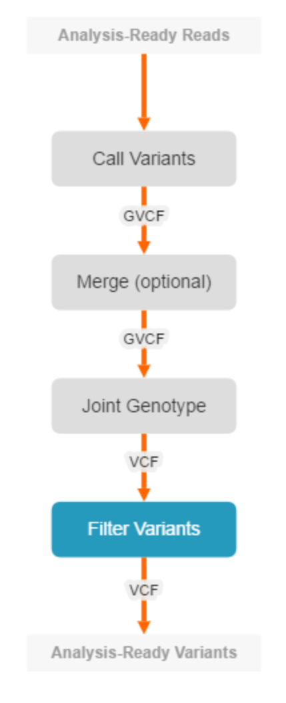
Quality filtering
Most mammalian genomes will have millions of variants
Therefore even low false positive rates will lead to large numbers of incorrect calls
Where there are available sets of known true variants can apply VQSR
Otherwise need to apply manual filtering

Slide 36
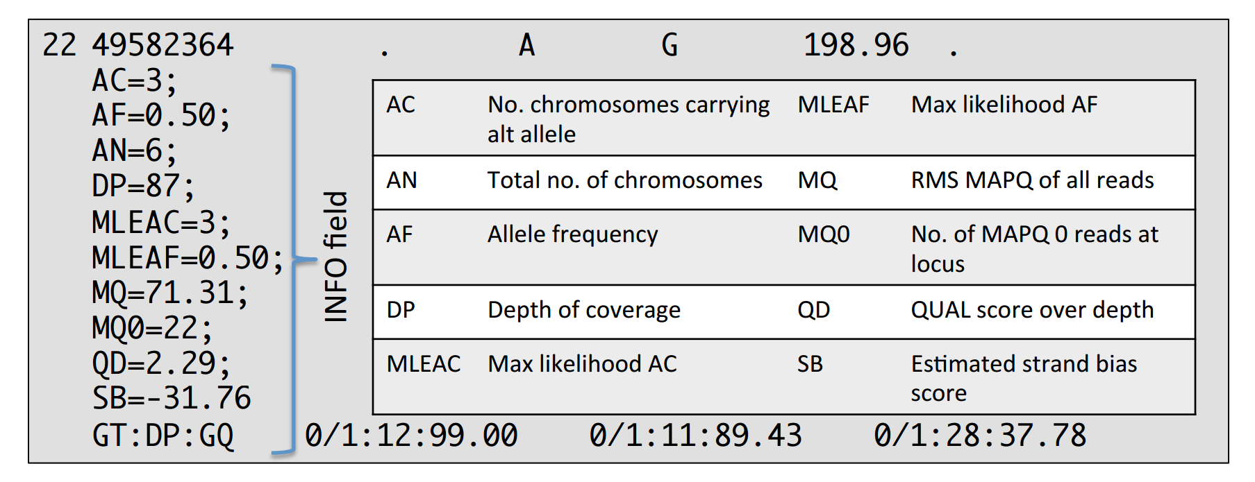
Variant quality score recalibration (VQSR)
Each variant is associated with a range of annotations
Can we learn what a good quality variant looks like?

Slide 37
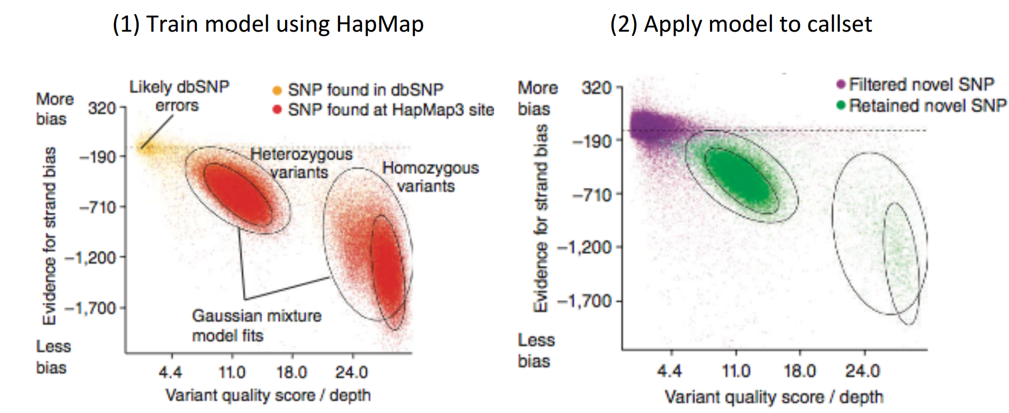
Variant quality score recalibration (VQSR)
Train model on variants found in good quality set – “Positive” model
Train model on variants least similar to good quality set – “Negative” model
Variants are ranked according to the ratio of their scores in each model

Slide 38
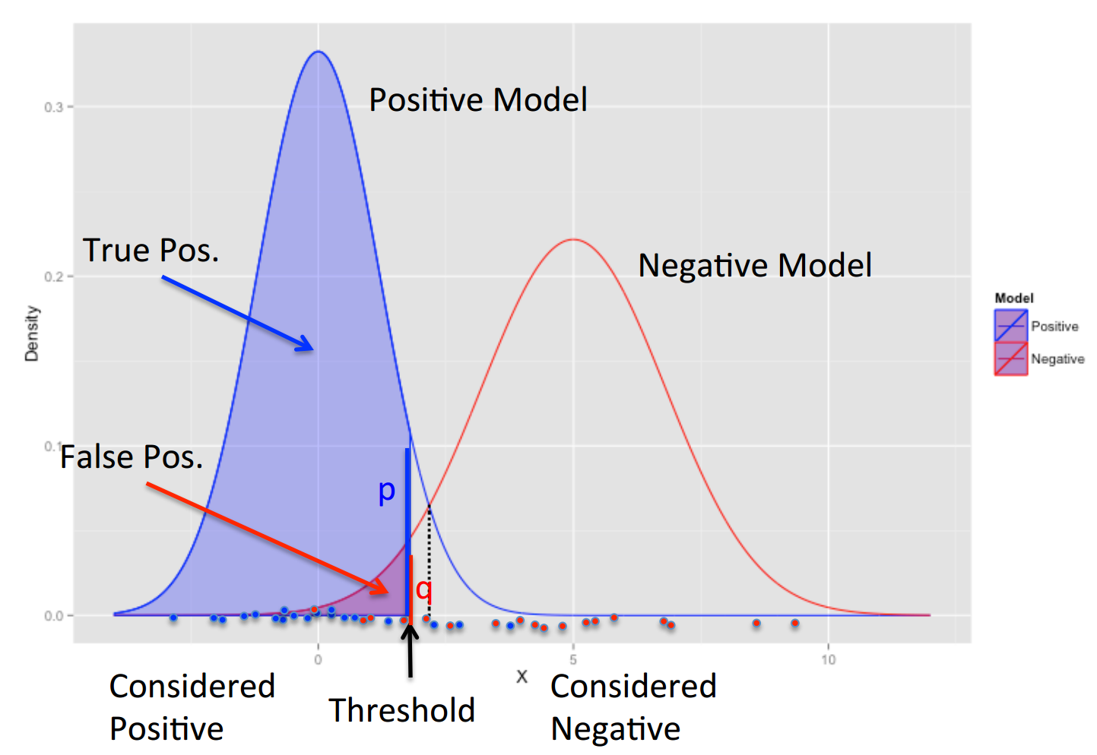
Variant quality score recalibration (VQSR)
Use “truth” dataset to determine tranche thresholds
At a given threshold what proportion of truth sites are captured?
Note SNPs and Indels are done separately

Slide 39
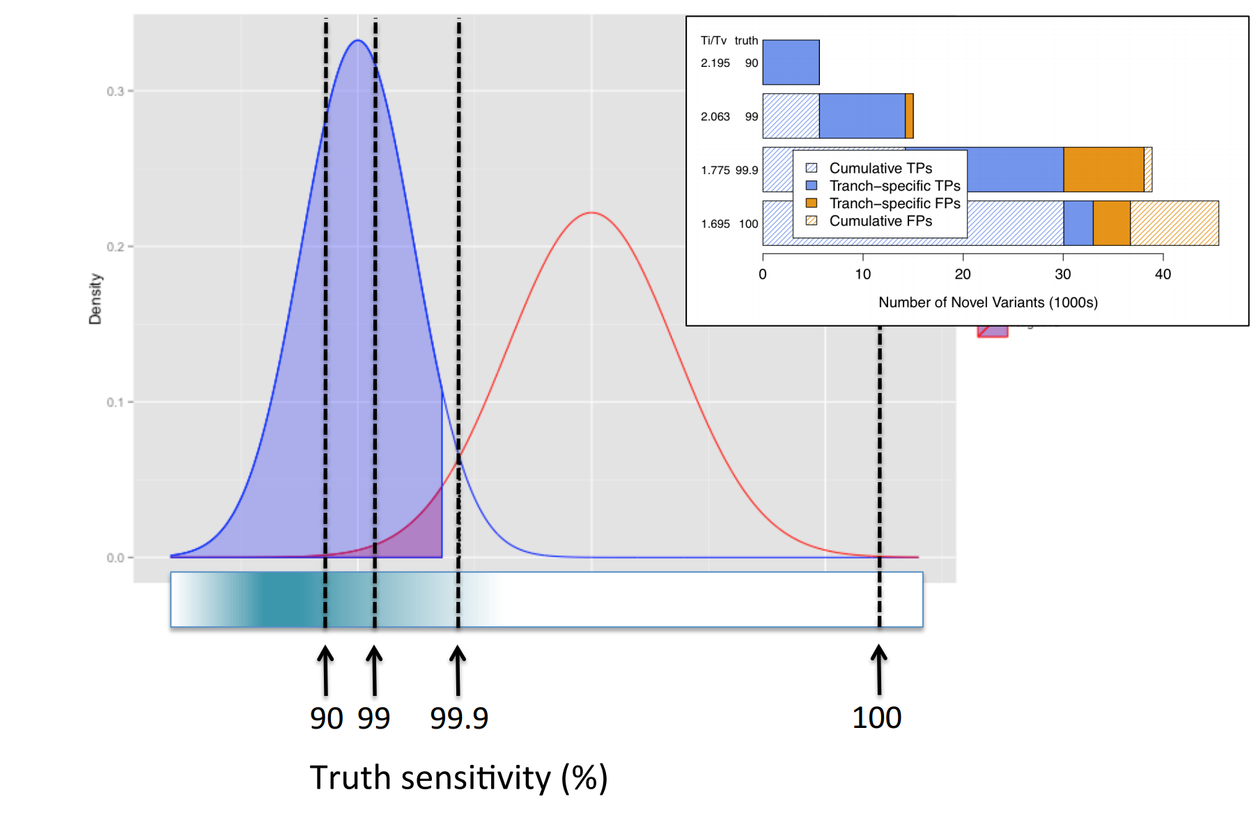
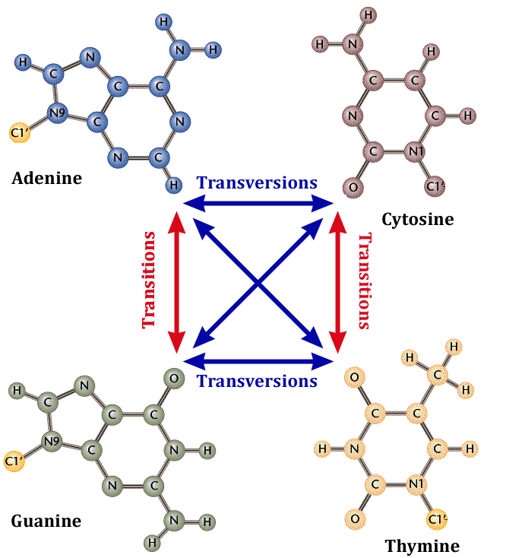
Variant quality score recalibration (VQSR)
Transition/Transversion ratio (Ti/Tv) can be used to check quality of variant sets.
For example in humans Ti/Tv ratio is around 2-2.2. However sequencing errors will have a much lower ratio

Slide 40
Manual filtering
VQSR only works with organisms with good “truth” sets.
Alternative is to apply manual thresholds on variant annotations using VariantFiltration in GATK
Knowing the best thresholds will likely be a matter of trial and error, best judgement and the cost of a false positive
Always worth eyeballing any variants of interest e.g. in IGV
Variant quality score normalized by allele depth
Strand bias
Comparison of mapping qualities of the reads supporting the reference allele with those supporting the alternate allele
java –jar GenomeAnalysisTK.jar –T VariantFiltration \
–R human.fasta \
–V input.vcf \
–filter "QD < 2.0 || FS > 60.0 || SOR > 4.0 || \
MQ < 40.0 || MQRankSum < -12.5 || \
ReadPosRankSum < -8.0" \
–filterName ”SNP_filter" \
–o filtered_snps.vcf
Reads mapping quality
Any bias of the position in the reads where the variant is called

Slide 41
https://github.com/prenderj/variant_tutorial
Step 7

Slide 42
Variant annotation and filtering

Slide 43
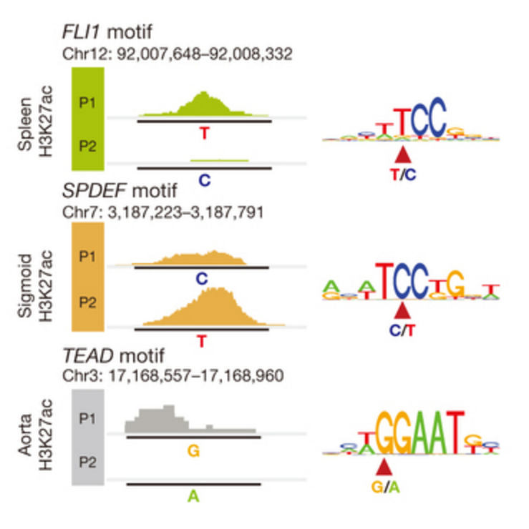
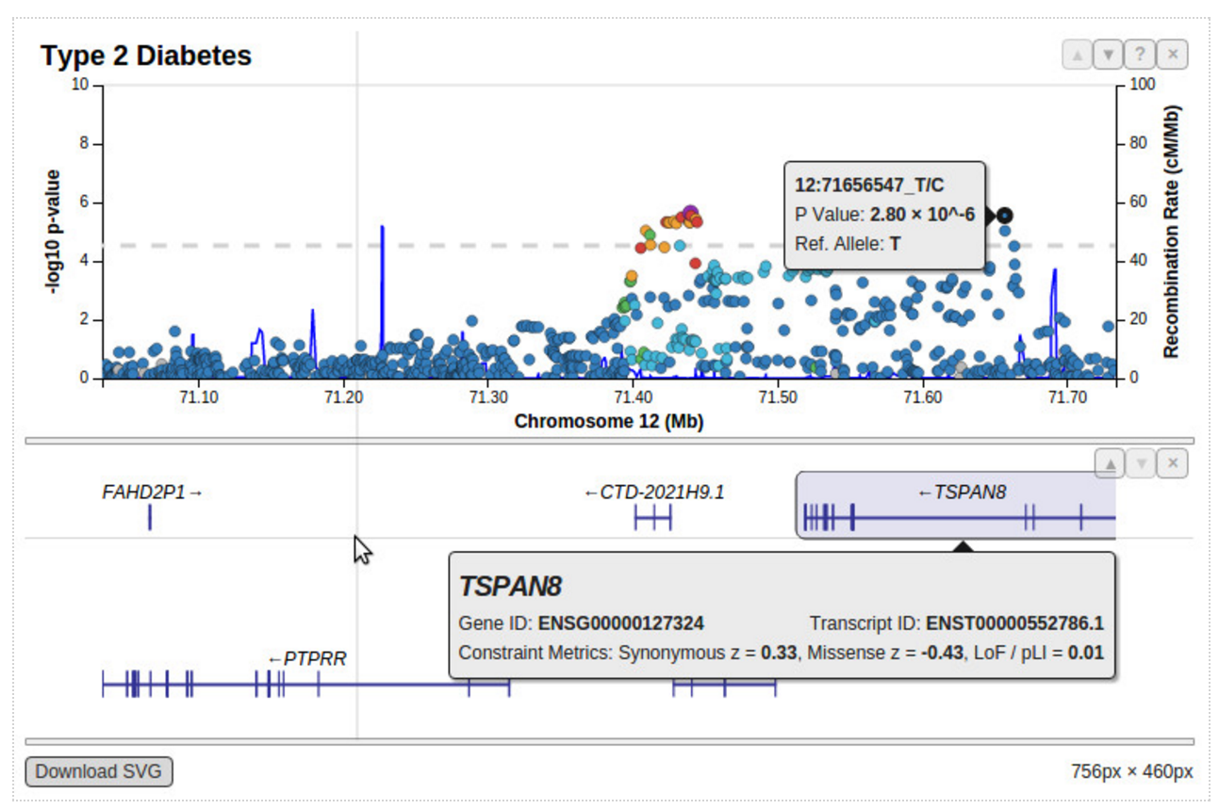
Why annotate?
Determine which variant is best candidate due to its consequence
Understanding why a variant may be functional
Nature Article number: nature14312 (2015)

Slide 44
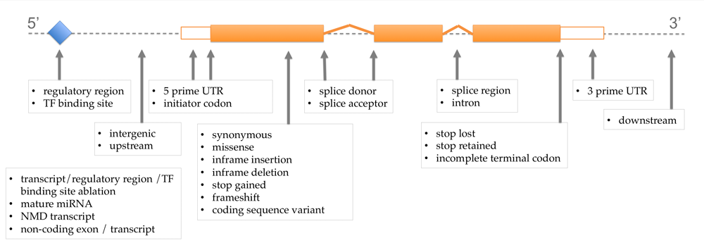
Consequences of variants
Despite millions of variants in most mammalian genomes the majority are expected to be non-functional
Potentially less than 1-2% are coding, less than 10% in evolutionary conserved regions

Slide 45
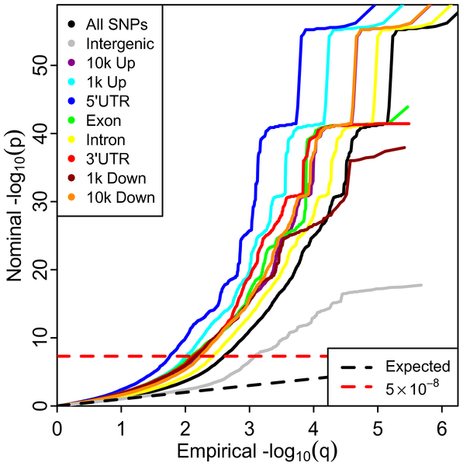
Not all variants are equally important
Figure 1. Stratified Q-Q plot for height shows enrichment by annotation categories.
Promoter/5’UTR variants most likely to be functional
Intergenic variants least likely to be functional (for height in this study)
PLOS Genetics 9(4): e1003449. doi:10.1371/journal.pgen.1003449

Slide 46
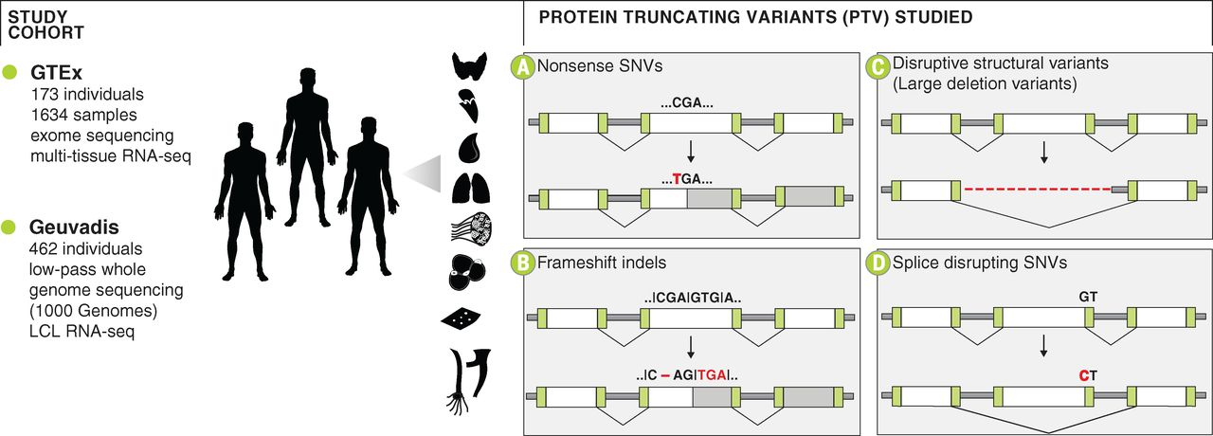
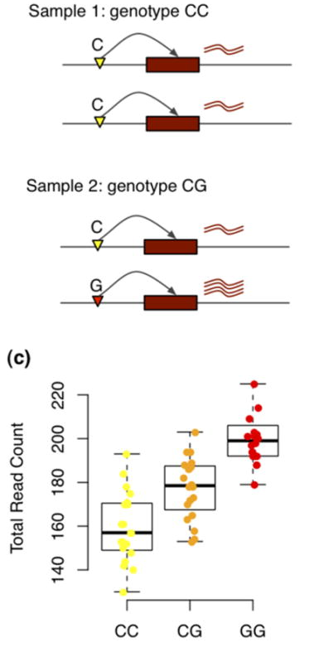
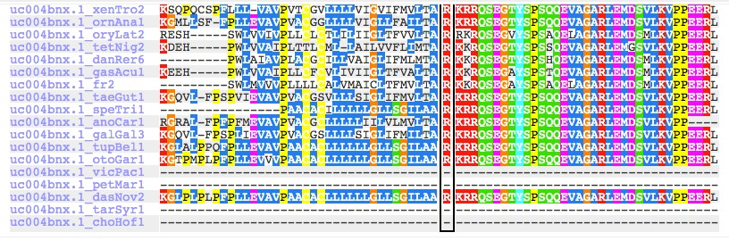
Variant annotations
Gene based
Conservation based
Effect on coding regions
e.g.
Protein truncating/
altered splice site/change in charge of AA etc
Effect on non-coding regions
e.g.
Disrupts transcription
factor binding motif
Variant is an eQTL
Strongly conserved genomic regions are more likely to be functional (e.g. GERP)
Changes to an amino acid not observed at the position in any species more likely to be deleterious (e.g. SIFT/polyphen)
Stop codon
gained
Frameshift
indel
Splice site
variant

Slide 47
Annotation tools
Name | OS | Input | Output | SNP | INDEL | CNV | GUI | CLI (command line) | Web | Function/Location Parameters | DB IDs | Number of scores
ANNOVAR | Lin, Mac, Win, web interface | VCF, pileup, CompleteGenomics, GFF3-SOLiD, SOAPsnp, MAQ, CASAVA | TXT | Yes | Yes | Yes | No | Yes | No | 9 (func) + 11(exonic-func) | Yes | GERP++ conservation, LRT, MutationTaster, PhyloP conservation, PolyPhen, SIFT
AnnTools | Lin, Mac | VCF, pileup, TXT | VCF | Yes | Yes | Yes | No | Yes | No | 5 (position) + 4 (functional class) | Yes | –
NGS–SNP | Lin, Mac | VCF, pileup, MAQ, diBayes, TXT | TXT | Yes | No | No | No | Yes | No | 17 | Yes | Condel, PolyPhen, SIFT
SeattleSeq | web interface | VCF, MAQ, CASAVA, GATK BED, custom | VCF, SeattleSeq | Yes | Yes | No | No | No | Yes | 11(dbSNP) + 5 (GVS) | Yes | GERP, Grantham, phastCons, PolyPhen
snpEff | Lin, Mac, Win | VCF, pileup/TXT (deprecated) | VCF, TXT, HTML overview | Yes | Yes | No | No | Yes | No | 34 | Yes | –
SVA | Lin | VCF, SV.events file, BCO | CSV | Yes | Yes | Yes | Yes | Yes | No | 17 (SNP), 17 (INDEL), 10 (CNV) | Yes | –
VARIANT | web interface | VCF, GFF2, BED | web report, TXT | Yes | Yes | No | No | Yes | Yes | 26 | Yes | –
VEP | Lin, web interface | VCF, pileup, HGVS, TXT, variant identifiers | TXT | Yes | Yes | No | No | Yes | Limited | 28 | Yes | Condel, PolyPhen, SIFT
Brief Bioinform (2013) 15 (2): 256-278

Slide 48
Variant Effect Predictor
Supports the large number of species in Ensembl
Can input and output VCF files (as well as other formats)
As well as variant consequences can annotate transcription factor binding sites (TFBS) and provide evolutionary (e.g. SIFT) scores
For human data can add further annotations such as population allele frequencies
Runs in four modes: web portal, REST API, command line (online) and command line (offline)

Slide 49
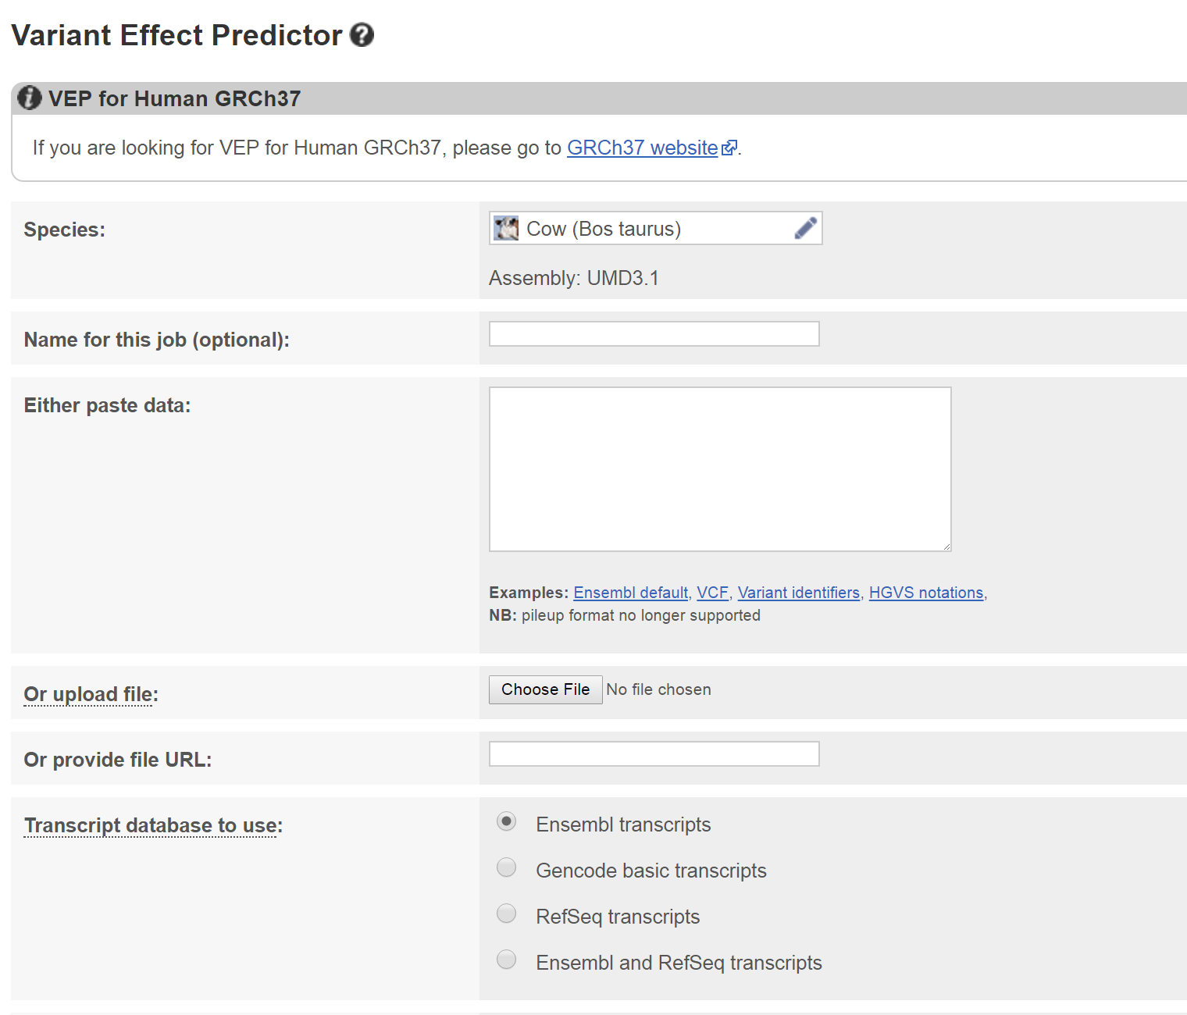
VEP – Using online site
http://www.ensembl.org/Tools/VEP
Good if just have a small number of variants to annotate

Slide 50
VEP – Using Ensembl REST API
Allows variant annotation from scripts in various programming languages
URL based
Can return XML/Json formatted data
Example perl script
use strict;
use warnings;
use HTTP::Tiny;
my $http = HTTP::Tiny->new();
my $server = 'https://rest.ensembl.org';
my $ext = '/vep/human/region/9:22125503-22125502:1/C?';
my $response = $http->get($server.$ext, {
headers => { 'Content-type' => 'application/json' }
});
die "Failed!\n" unless $response->{success};
use JSON;
use Data::Dumper;
if(length $response->{content}) {
my $hash = decode_json($response->{content});
local $Data::Dumper::Terse = 1;
local $Data::Dumper::Indent = 1;
print Dumper $hash;
print "\n";
}
[
{
"input": "1 6524705 6524705 C/T 1",
"assembly_name": "GRCh38",
"end": 6524705,
"seq_region_name": "1",
"strand": 1,
"transcript_consequences": [
{
"gene_id": "ENSG00000162408",
"variant_allele": "T",
"cdna_end": 3291,
"biotype": "protein_coding",
"gene_symbol_source": "HGNC",
"consequence_terms": [
"3_prime_UTR_variant"
],
"hgnc_id": "HGNC:26265",
"strand": -1,
"gene_symbol": "NOL9",
"transcript_id": "ENST00000377705",
"cdna_start": 3291,
"impact": "MODIFIER"
},
……
Example output

Slide 51
VEP – command line
Download and unpack: http://www.ensembl.org/info/docs/tools/vep/script/vep_download.html
Install VEP and databases for species of interest
Run VEP
perl INSTALL.pl --AUTO --SPECIES bos_taurus,homo_sapiens
Try and install without prompts
Species want to use it with
perl variant_effect_predictor.pl --cache --species bos_taurus --format vcf --vcf -i in.vcf -o out.vcf
Use the cached version of database (quicker)
Species
Write output
In VCF file
Names of input and output files
Format of input file

Slide 52
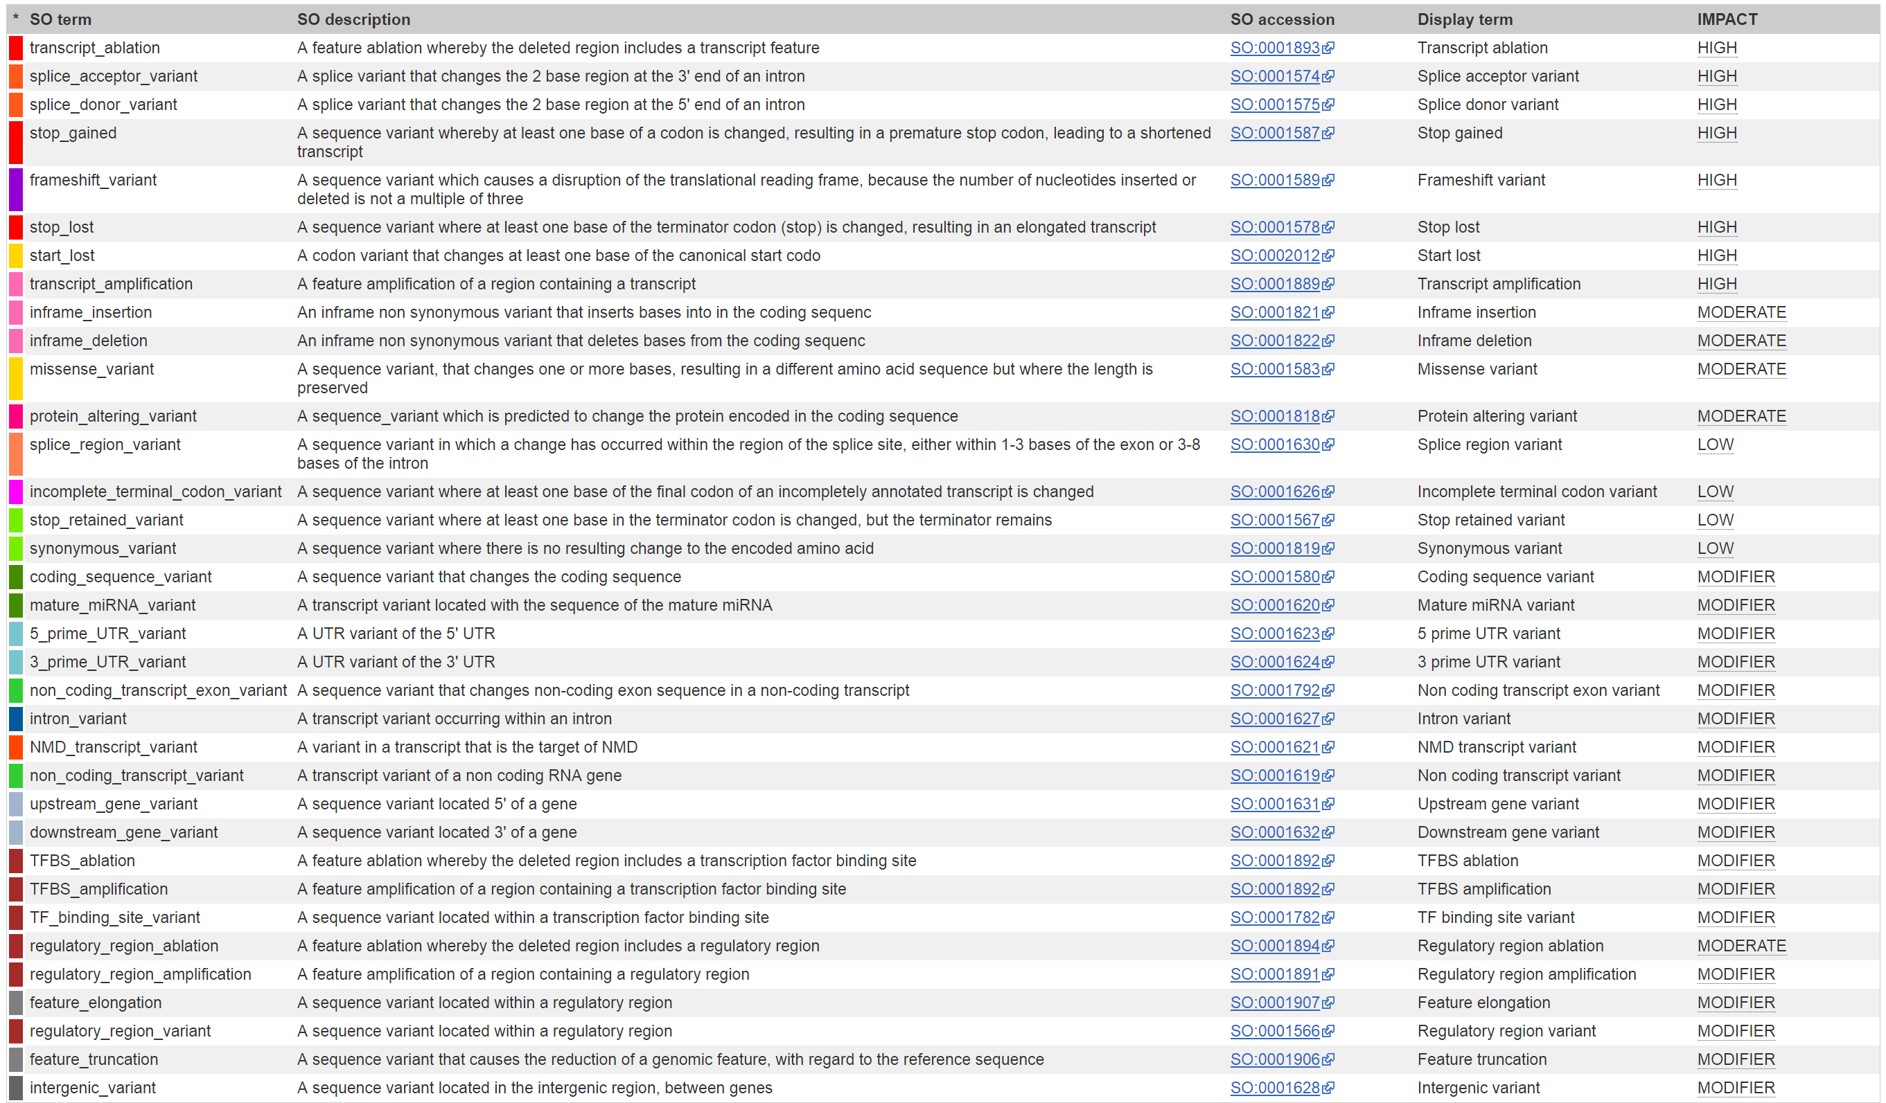
--most-severe option
Multiple transcripts can overlap variant. Rather than get all consequences for all transcripts just keep the most severe consequence according to their rank in this table

Slide 53
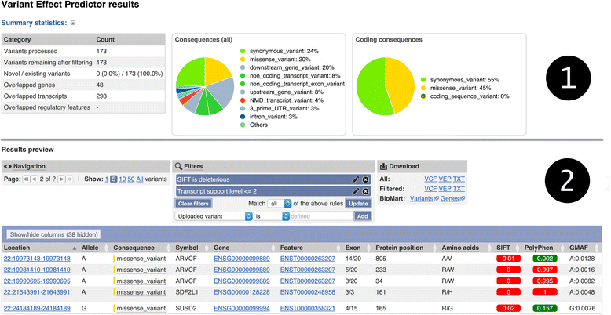
VEP html output file
Global minor allele frequency if known (human only)
Predictions of whether AA change is deleterious according to cross-species conservation
(--sift and --polyphen flags)

Slide 54
VEP VCF output
VEP adds consequence information to INFO field. Format described in the header
Can use filter_vep.pl to select particular types of variants from file
##INFO=<ID=CSQ,Number=.,Type=String,Description="Consequence annotations from Ensembl VEP. Format: Allele|Consequence|IMPACT|SYMBOL|Gene|Feature_type|Feature|BIOTYPE|EXON|INTRON|HGVSc|HGVSp|cDNA_position|CDS_position|Protein_position">
#CHROM POS ID REF ALT QUAL FILTER INFO
21 26978790 rs75377686 T C . . CSQ=C|missense_variant|MODERATE|MRPL39|ENSG00000154719|Transcript|ENST00000419219|protein_coding|2/8||ENST00000419219.1:c.251A>G|ENSP00000404426.1:p.Asn84Ser|260|251|84
perl filter_vep.pl -i in.vcf -o out.txt --filter "Consequence matches stream" --count
Input and output files
The filter to apply. In this case just keep variants where “stream” is in consequence i.e. is either an upstream or downstream variant
Just output the count of variants that match this filter. Leave this flag out if want details of each variant

Slide 55
Variant filtering with VCFtools
VCFtools can be used to extract subsets and metrics from a VCF file, including:
Create new VCF with just variants or individuals passing certain filters, such as those in a region or above a certain frequency or quality.
Create LD statistics between variants
Get population genetics statistics such as F_{st}
vcftools --vcf input_data.vcf --chr 1 --from-bp 1000000 --to-bp 2000000 --recode --recode-INFO-all --out region_variants
Input file
Output a VCF
formatted file
Just get variants in this region
on chromosome 1
Keep INFO field details in output (e.g. VEP info)
Prefix of output file

Slide 56
Genetic association studies

Slide 57
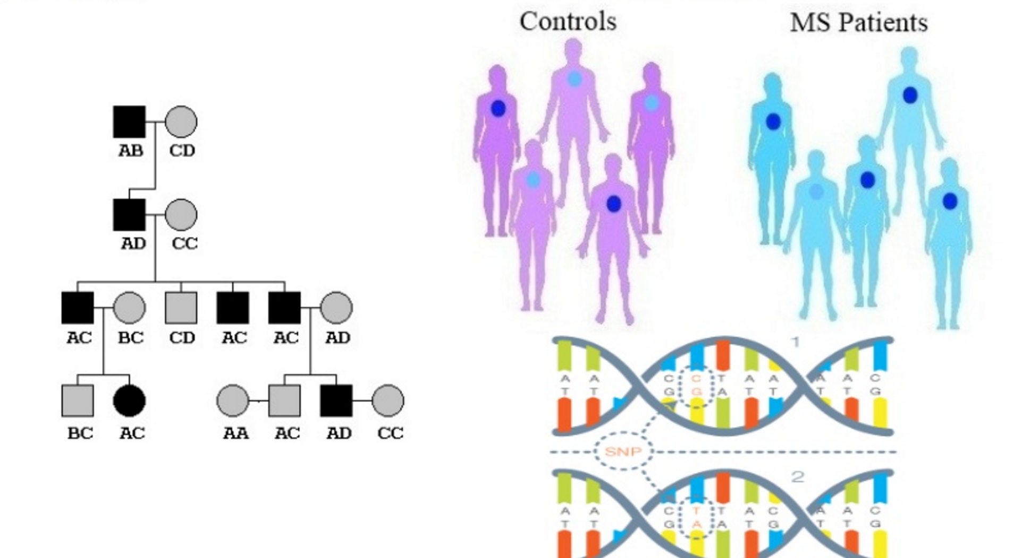
Linkage vs Association
Linkage study
Association study
Does a genomic region segregate with the phenotype in a family
Is an allele/genotype enriched among unrelated individuals with the disease/trait
http://www.slideshare.net/LekkiFrazierWood/lecture-6-candidate-gene-association-full

Slide 58
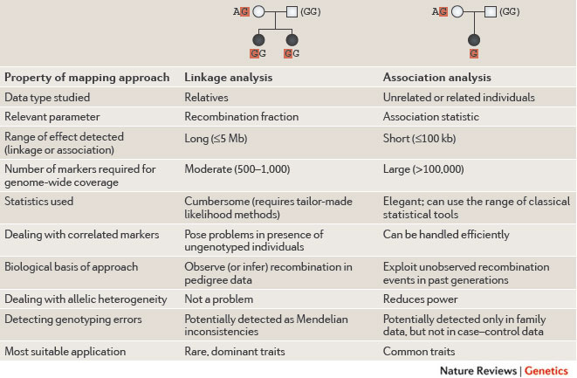
Linkage vs Association
Nature Reviews Genetics 12, 465-474 (July 2011)

Slide 59
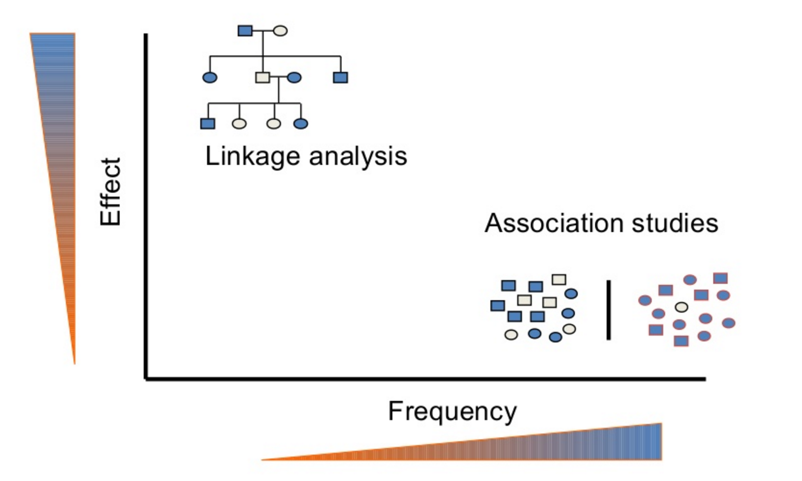
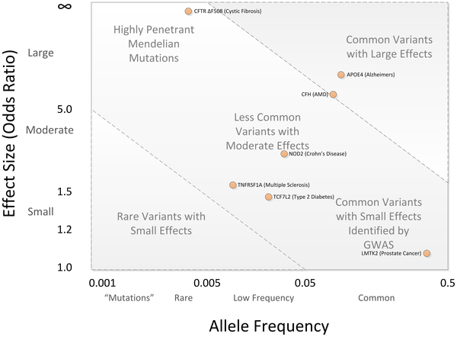
Study choice
Importantly the different studies can better detect different loci
PLOS Computational Biology 8(12): e1002822. doi:10.1371/journal.pcbi.1002822
http://www.slideshare.net/LekkiFrazierWood/lecture-6-candidate-gene-association-full

Slide 60
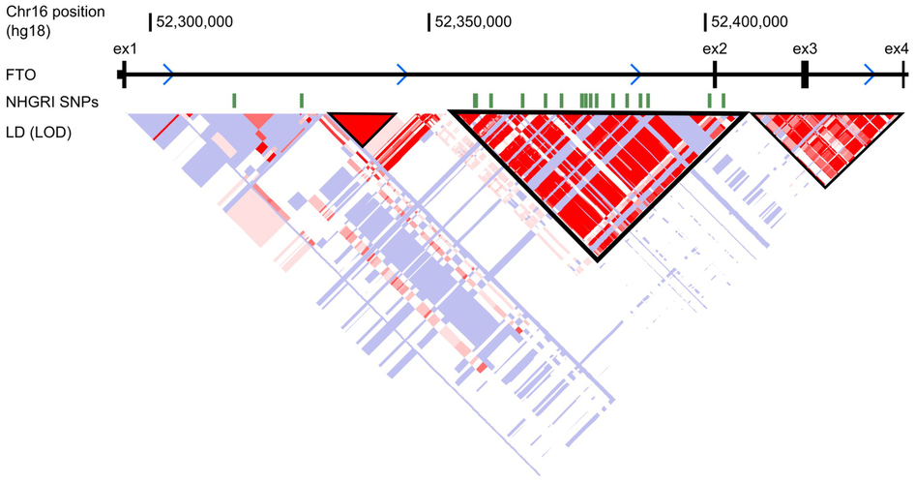
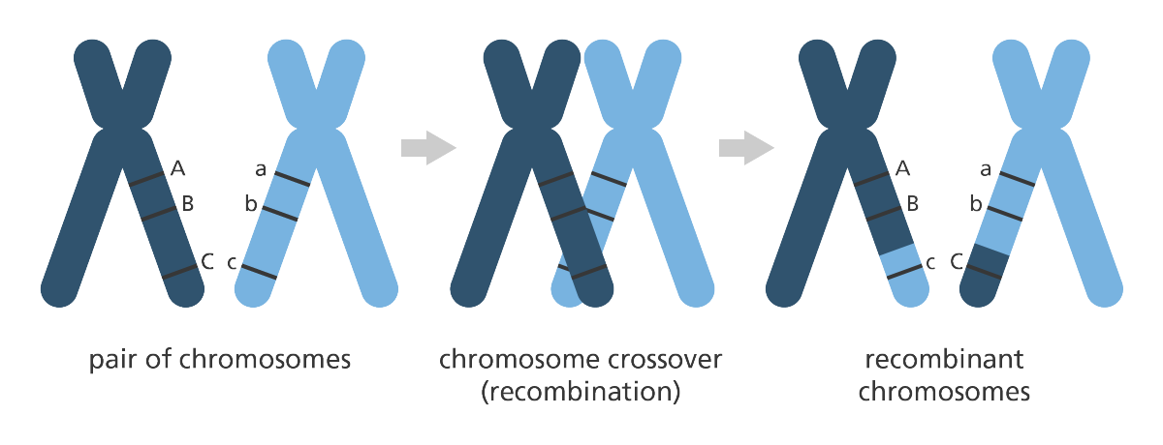
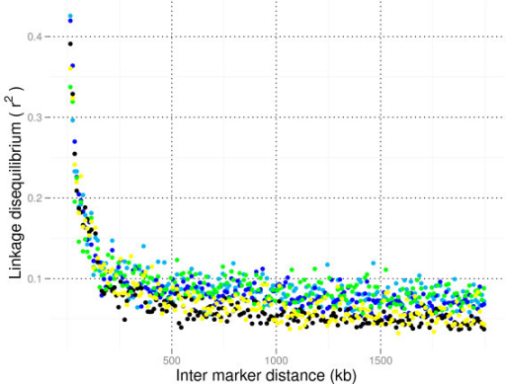
Linkage disequilibrium
Variants in high LD i.e. genotypes are highly correlated
From Genome research
Nature 507, 371–375 (20 March 2014)
Recombination breaks down links between distant variants (e.g. A and C)
Link between nearby variants (e.g. A and B) less likely to be broken down and variants likely to be inherited together across generations
Cattle LD – LD drops rapidly with distance
BMC Genomics. 2011; 12: 33.

Slide 61
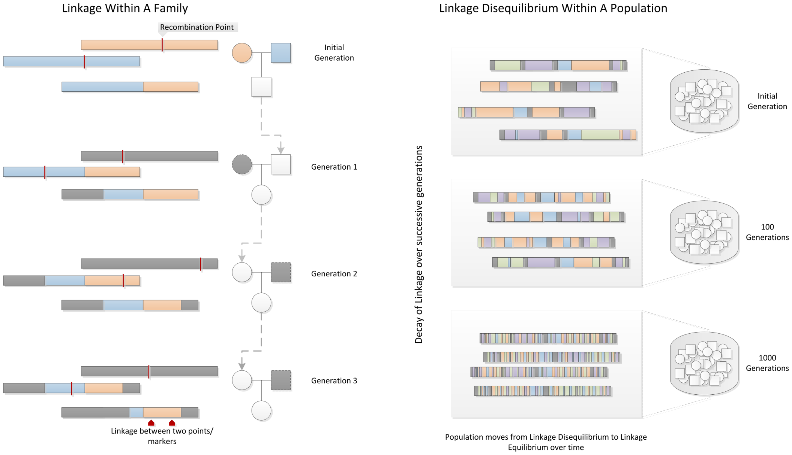
Linkage and GWAS depend on recombination
PLOS Computational Biology 8(12): e1002822.

Slide 62
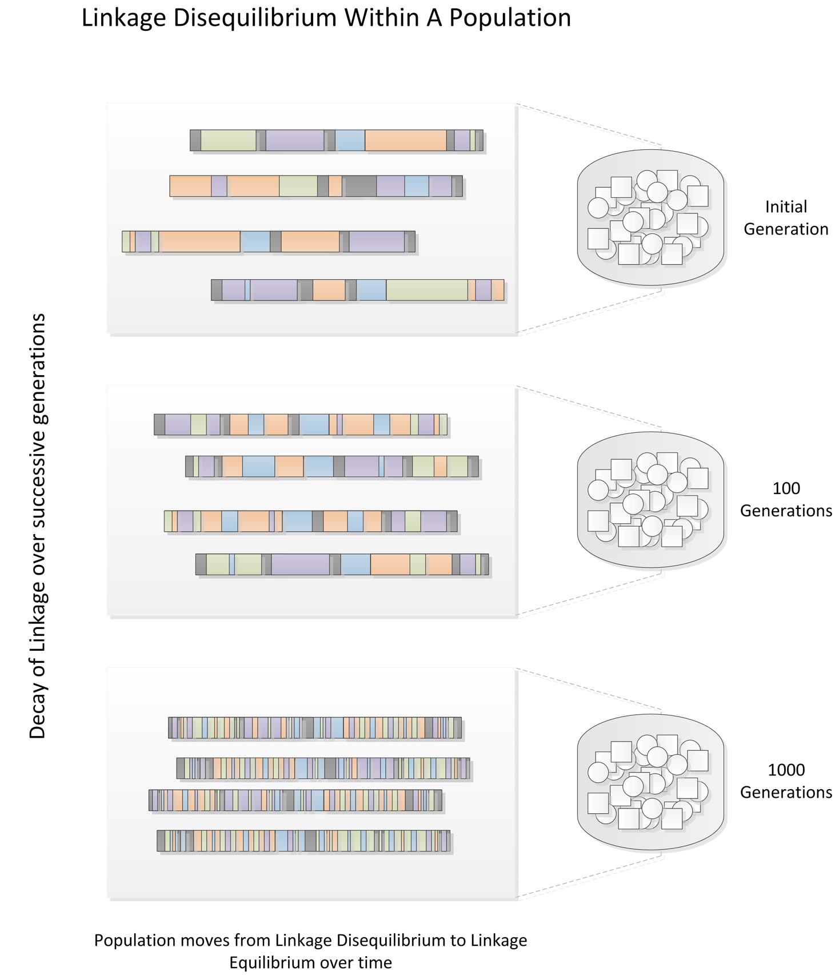
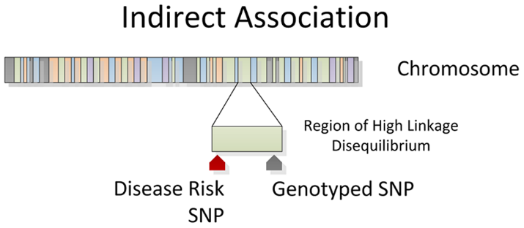
GWAS traditionally depend on LD
LD means less variants need to be genotyped
However means determining causative variant is difficult
Variant prioritisation can help identify candidate causative variant among those in high LD
PLOS Computational Biology 8(12): e1002822.

Slide 63

GWAS pipeline
Nature Reviews Drug Discovery 7, 221-230 (February 2008)

Slide 64


Types of phenotype
Dichotomous traits e.g. diseases like cancer
Quantitative traits e.g. height, weight
Cases
Controls
Nature Reviews Genetics 10, 872-878 (December 2009)

Slide 65


Regression tests
Testing whether phenotype differs between individuals with different genotypes
If slopes of lines ~ 0 then no association between locus and phenotype
Case control study
Quantitative trait
Tests used include:
Cochran-Armitage test
Logistic regression
Tests used include:
Multiple linear regression
Nature Reviews Genetics 7, 781-791 (October 2006)

Slide 66

Different models
Just one copy of the B allele is sufficient to exhibit maximum phenotype
Phenotype increases with each extra copy of B allele an individual carries
Individual needs to carry two copies of B allele to exhibit maximum phenotype
Phenotype maximum when individual is heterozygote (heterozygote advantage)
Can test different models by changing how the genotypes are coded in the regression model
Yakov A. Tsepilov et al. Genetics 2015;200:707-718

Slide 67


GWAS approach
Test each variant in turn
Identify significant loci
Nature 447, 661-678 (7 June 2007)

Slide 68

Spotting potential problems with Manhattan
Plot log transformed p values along genome
Bad manhattan plot
Significant results are outliers. Contrary to what expect given LD structure of genome
Good manhattan plots
Associations found across specific genomic regions
Paper eventually withdrawn from Science
Outliers found to be differences in genotyping platforms used in cases and controls
Science 01 Jul 2010
Nature 447, 661-678 (7 June 2007)

Slide 69
Importance of environment
Need to check trait is in fact heritable!
Environment can confound the trait making the genes harder to find
Need to control for this by correcting for any differences in environmental exposure between individuals
Environment
Genes
Cystic fibrosis
Mendelian trait
Environment has little role in getting disease
Height
Highly heritable
Strong genetic component but environment plays a role e.g. diet
Political preference
Environmental
Limited if any genetic component

Slide 70



Environmental factors often more important
Individuals with Japanese parents but brought up in USA are up to four times more likely to get colorectal cancer than people in japan
Same genes but different food and environment
Genetics explains only around 20% of colorectal cancer risk

Slide 71

Problem of population structure
False positives can arise if one population is over-represented among cases or controls
Artefacts can also arise if for example different populations or groups are genotyped on different platforms, collected in different ways, are of different sex or age profiles etc
Any differences need to be accounted for
Nature Reviews Genetics 7, 781-791 (October 2006)

Slide 72

Assessing population structure
Can assess population structure using principal component analysis (PCA)
Where structure is observed can statistically account for it using information from the PCA
Nature 456, 98-101(6 November 2008)

Slide 73

Metaanalyses
Can integrate results from different populations via a metaanlysis
Can be carried out on summary statistics
Some effects can only be detected by studying large sets of cohorts in this way
Also helps show effect is not restricted to one group
SNP not associated with phenotype in many individual studies
Some studies can even show different direction of effect
However when combine results find strongly significant link between variant and phenotype
Nature Genetics 44, 187–192 (2012)

Slide 74

Problem of multiple testing
The more tests you perform the more likely will find a significant result by chance
Whole genome association studies can involve millions of tests
Need to therefore apply strict significance threshold
Can use Q-Q plot to assess whether likely have true positive associations by plotting observed distributions of (log transformed) p values against distribution expected under the null
Test done appropriately but no associations found
Inflation suggests e.g. population structure not accounted for
Ideal plot
Points at top deviating from line are potential true hits
Nature Reviews Genetics 9, 356-369 (May 2008)

Slide 75

Problem of multiple testing (2)
Can correct for multiple testing in multiple ways e.g.:
Bonferroni correction: 0.05/(number of tests performed) e.g. 0.05/100000 = 5x10⁻⁷
Anything with p less than this threshold deemed significant. However Bonferroni correction widely accepted to be too stringent.
False discovery rate correction e.g. q values. Estimates the proportion of results beyond threshold that are expected to be false positives. Set FDR threshold to 0.05 i.e. only 5% of hits are expected to be false positives
Bayesian thresholds estimate prior hypothesis any given variant is associated with a disease and adjust accordingly
Fallen out of favour, primarily due to problem of coming up with accurate, unbiased priors
Many studies just apply a commonly accepted threshold of p < 5x10⁻⁸. Bit of a cheat
Nature Methods 11, 355–356 (2014)

Slide 76
PLINK
Software for performing GWAS
First published in 2007 (since cited around 12000 times)
Substantially updated version PLINK 2 under active development (https://www.cog-genomics.org/plink2/)
Note several other software packages available e.g. GenABEL/ProbABEL, EMMA

Slide 77
PLINK – (very!) basic workflow
VCF file
Data formatting
Convert to PLINK’s binary format
QC of data
e.g. filtering by missingness/HWE
Check for population stratification
GWAS
Fitting appropriate covariates
Plotting
Q-Q plot, Manhattan plot
Multiple test correction
Calculate FDR

Slide 79

https://www.ncbi.nlm.nih.gov/pmc/articles/PMC3593722/

Slide 80

Nature Reviews Genetics 17, 93–108 (2016)

